Slide 1
Director of Public Health Report
Dr Tim Patterson

Slide 2
Adopts the Public Health Priorities for Scotland as Scottish Borders priorities.
Sets out how we will work in partnership as a whole system to improve Borders health and reduce health inequalities.
It is a starting point for new preventative approaches and awareness raising.
Recognises the collective and individual roles we can play to lead more active, healthy lives.

Slide 3
Priority 1: A Borders where we live in vibrant, healthy safe spaces and communities

Slide 4
Why this is Important
RELATIVE CONTRIBUTION OF THE DETERMINANTS OF HEALTH
Health Behaviours 30% | Socio-economic Factors 40% | Clinical Care 20% | Built Environment 10%
Smoking 10% | Education 10% | Access to Care 10% | Environmental Quality 5%
Diet/Exercise 10% | Employment 10% | Quality of Care 10% | Built Environment 5%
Alcohol Use 5% | Income 10%
Poor Sexual Health 5% | Family/Social Support 5%
Source: Marmot Report | Community Safety 5%

Slide 5
Key Area for action
A Health in All Policies approach to sustain collaboration and enable policy decisions to be seen through a health and equity lens.

Slide 6
Priority 2: A Borders where we flourish in our early years

Slide 7
Why this is Important
Investing early in our young people’s future is the best form of prevention.
ACEs are associated with long term harm
~10,000-15,000 adults in Borders could have 4 or more ACEs
1 in 5 children live in relative poverty
A range of evidence based interventions can be taken by local partners to reduce ACEs and their impact.

Slide 9
Key Areas for Action
All services should recognise the impact of ACEs.
Reduce the proportion of children living in relative poverty through addressing its wider causes.
Support health of mothers before or in early pregnancy.
Focus on families who face complex issues to find ways to improve outcomes for children.
The voices of young people need to be heard by planning and priority setting bodies.

Slide 10
Priority 3: A Borders where we have good mental wellbeing

Slide 11
Why this is Important
Our ambition is of a community which works together to value and promote a holistic approach to mental health and wellbeing.
Good mental health is profoundly important for growth, development, learning, resilience and is linked to wider inequalities.

Slide 12
Why this is Important
Mental illness affects 1:4 adults and 1:10 children.
Three quarters of mental health problems have emerged by age 20.
Suggests that ~19,800 adults and 1,898 CYP living in Borders will experience mental ill health.

Slide 14
Key Areas for Action
Mental health needs to be given the same attention as physical health.
Everyone’s business: a broad multi-stakeholder approach to support mental wellbeing for all.
Children and young people’s mental health identified as a priority at national level
Taskforce recommendations set direction of change.

Slide 15
Priority 4: A Borders where we reduce the use of and harm from alcohol, tobacco and other drugs

Slide 16
Why this is Important
Our ambition is for a Borders where people do not develop problematic substance use and where people who have problems are supported and respected.
The majority of harm across Borders due to substance use is not due to addiction, dependency or illegal drug use, but rather due to smoking and the large number of people regularly drinking alcohol above the lower risk guidelines.

Slide 17
Smoking in the Borders
Overall prevalence rates are falling.
But still 245 smoking related deaths per year.
There is a significantly higher than average rate of smoking in pregnancy in the Scottish Borders(19.4%) than the Scottish average (16.3%).
Rates are known to be higher in more deprived areas.

Slide 18
Drinking in the Borders 1

Slide 19
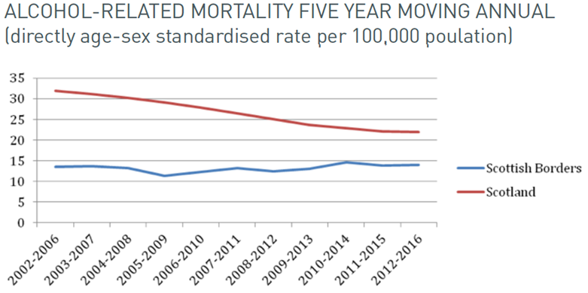
Drinking in the Borders 2

Slide 20
Drug related deaths
in the Borders

Slide 21
Key Areas for Action
Reduction of smoking in pregnancy is a very high priority.
A significant proportion of adults drink in excess of guidelines.
Reducing harm from substance use continues to be a priority; the trend in drug related mortality must be reduced.
SBC has the power and duty to protect and improve public health through the licensing of alcohol sales and availability.

Slide 22
Priority 5: A Borders where we have a sustainable, inclusive economy with equity of outcomes for all

Slide 23
Why this is Important
All residents have the right to good health and equal opportunities to lead healthy, safe and fulfilling lives.
Poverty and inequality remain the most important challenge to health. The majority of health differences find their cause in differences in wealth and income.

Slide 25
What we are doing in the Borders
Initiatives such as the ‘Edinburgh and South East Scotland City Region Deal’, the ‘Borderlands Initiative’ and the establishment of a South of Scotland Enterprise Agency will help further grow the economy of the area.
The Borders Community Planning Partnership has also agreed 3 key priorities:
Grow our economy and maximise the impact of the low carbon agenda.
Reducing inequalities.
Future service reform.
CPP’s inequalities work stream focuses on child poverty to tackle drivers of child poverty .

Slide 26
Key Areas for Action
Underpinning all our actions to grow our economy must be an approach which narrows health inequalities.
A HiAP approach needs to be embedded in Scottish Borders CPP and partner organisations.
The health of communities now and in the future depend upon us living within sustainable limits.

Slide 27
Priority 6: A Borders where we eat well, have a healthy weight and are physically active

Slide 28
Why this is Important
During 2013-2016, most adults in the Borders were overweight or obese (68%).
Over 1/3 of adults did not meet guidelines to undertake 150 minutes per week of moderately vigorous physical activity.
78% of adults did not consume the recommended five a day portions of fruit and vegetables.

Slide 30
Key Areas for Action
Address the obesogenic environment by making the Borders a place where it is easy to make the healthy choice.
Further develop prevention activities for overweight and obesity.
Increase robust signposting to services.
Ensure prevention activities are appropriately targeted.
Address disproportionate system investment towards treatment, rather than primary prevention.
Ensure staff have time to provide detailed prevention advice.
Focus our efforts on the whole life course.

