Slide 1
Scottish Borders Autism Strategy
Level 2d: Autism Informed
Social Imagination

Slide 2
Welcome to the fourth Autism Informed e-module.
This PowerPoint learning module is best viewed in Slide Show mode. If you are not currently viewing in this mode, you can switch by clicking on the “Slide Show” tab above, and then on “From Current Slide”.
Use your mouse, or the right arrow on your keyboard to move through the presentation. Some of the slides may have links to websites with video or more information. If you click on them, a webpage will open in a separate window.
At some points, you will be asked to reflect on your own experiences. You may wish to have a pen and paper to take notes of your responses.
The module should take approximately 40 minutes to complete.

Slide 3
This is the third of five Autism Informed modules. These modules build on the information and ideas contained in the Scottish Borders Autism Strategy: Autism Aware module, which you should complete first.
The Autism Informed modules will give you information and insight that will help you to understand and support Autistic people you know or work with. You might work in a role where you come across Autistic people from time to time. Or you may encounter people who respond to change in unexpected ways, or whose behaviours seem unusual to you, without you knowing whether they are Autistic. These modules will also give you a solid base to go on to further, specialist training if you work specifically with Autistic people.
All our modules have been created with advice and guidance from Autistic people, parents and carers from the Scottish Borders. Importantly, these modules have been designed to give you insight and empathy as to how Autistic people may experience the world, and the challenges they may face. Throughout the modules, we use the term “Autism” to include all Autistic Spectrum Conditions including Asperger’s Syndrome.
In this module, we will explore:
What is social imagination?
What kinds of repetitive, restrictive behaviours might Autistic people display?
How does Autism impact on an individual’s experience of change?

Slide 4
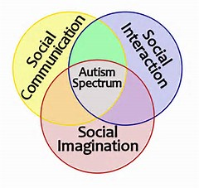
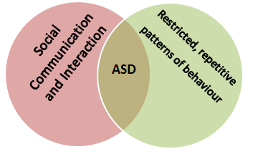
Recap
Social Imagination is one aspect of the “Triad of Impairment” (or “Triad of Difference”) which has informed our understanding of Autism for many years. Identifying particular differences (or “impairments”) in each area has been key to the diagnosis of Autism. Social imagination remains a distinct part of the Dyad of Difference, in more recent understandings of Autism.
In the Autism Aware module, we noted that:
Having difficulties with social imagination means Autistic people can experience the world as chaotic, confusing and out of their control. To cope with this, people may rely on routines, use repetitive behaviours, or have restricted interests.
These behaviours are what professionals look for in the diagnostic process.
Let’s start by defining what we mean by “social imagination”.

Slide 5
Understanding Social Imagination
“Social imagination is the capacity to invent visions of what should be and what might be [in our world]…”
Maxine Greene, Sociologist and Philosopher.
Social imagination enables us to use past experiences to predict what might happen in the future. Whenever someone thinks about what “might” happen, they are using their social imagination.
I’d better hurry, or the supermarket will be closed…
…and then I won’t have any milk for my cereal in the morning.
If I turn this box upside down, I can sit on it like a stool.
He’ll be really upset if I forget his birthday.
I think you would really like living in the countryside.
If I don’t stop this module now, I’ll be late for my meeting.

Slide 6
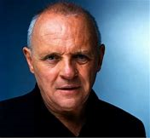
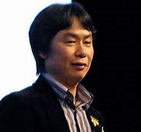
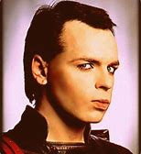
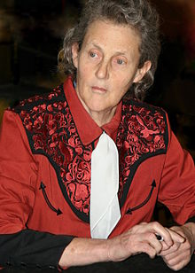
It’s important to recognise that social imagination isn’t the same as creative imagination. Having differences with social imagination doesn’t mean that Autistic people can’t be creative or imaginative. Here are some famous creative Autistic people:
Sir Anthony Hopkins is probably considered one of the world’s greatest actors. He is best known for playing Hannibal Lecter, but is also a director and musician.
Daryl Hannah is an American actress known for films such as Bladerunner, Splash, Wall Street and Kill Bill.
She’s also an environmental activist.
Gary Numan was a pioneer in electronic music in the late 1970s and 1980s. He had two no1 singles, “Are friends electric?” and “Cars” which have been widely sampled by other artists. He continues to perform today.
Satoshi Tajiri is the creator of Pokemon, the massively popular video game series.
Temple Grandin transformed the American meat industry with her innovative processing plant designs that reduce stress in animals.
Temple was one of the first people to publicly acknowledge that she is Autistic. She’s now an influential speaker, writer and advocate for Autism rights.
Stephen Wiltshire, MBE is a visual artist, known for his incredibly detailed architectural pictures, which he draws from memory.

Slide 7
Social imagination is linked to important life skills. Often, we use these skills without being aware of it. Social imagination processes can be subconscious, or so rapid that it seems instantaneous. Let’s look at an everyday example – going to the supermarket.
Click on to see the skills in action.
Planning and organising
Before going to the supermarket, you might make a list of what you need. If you’re low on toilet paper, you will put that on the list, because you imagine the consequence of running out, and it’s not good! If it’s a hot day, you might plan to collect refrigerated items last, imagining them spoiling if they get too warm.
Problem solving
If the supermarket has run out of your favourite brand, you might imagine how other products would be able to replace it, and choose something else.
If the product you want is at the back of the top shelf, you imagine different things you could do – climb up the shelves, ask a member of staff, go without, or choose something different . You pick the one that you most imagine having a positive result. You’d probably imagine how other people might react, and how you’d feel about being seen climbing up the shelves before choosing to do that!

Slide 8
Managing change and coping in unfamiliar situations
You get to the end of the aisle where milk is usually stocked, and biscuits are there, not milk. You know that it’s highly unlikely that a supermarket has stopped selling milk.
Your past experience of supermarkets tells you that sometimes they change things around, so you wouldn’t panic, you’d just look elsewhere for it.
Understanding time: past, present and future
When you choose food to buy, you imagine the length of time between now and the sell by date (how long that is, how many meals you’ll eat, what else you are doing) to help you decide whether to buy it or not. (You might imagine incorrectly and end up throwing away a lot of salad!)
You understand that you need to shop during opening hours, because you can imagine the shop open at that time, and closed at other times.
You probably won’t go and pay for each item one at a time, as you can imagine the sequence of choosing all your goods and paying at the end.
Understanding and predicting other people’s reactions and behaviours
If someone who lives with you is on a diet, you might not buy a trolley full of full-fat food, desserts and pies. You would predict that they wouldn’t eat them, and wouldn’t be very pleased with you.
You might be polite to the assistants, because your past experience has shown you that people are more likely to be helpful if you speak to them with respect.

Slide 9
You can probably see from those examples how important Social imagination is.
Imagine…
You take a trip to the supermarket, and aren’t able to use any social imagination skills. You can’t plan or make choices. You can’t predict how anyone will react to you, and can’t work out how to deal with changes. You know you’re shopping for a week, but don’t really know whether that’s a short time, or a long time.
If you’re unable to use your social imagination, your trip to the supermarket could be rather chaotic and unproductive.
You might buy things you don’t need, and forget things you do. Or buy way too much or too little.
You might end up standing in front of the bread for ages, trying to decide which one to buy, because they don’t have the wholemeal loaf you always buy.. Or go away without the washing up liquid you really needed because there was none on the shelf, and you didn’t know who you could ask for help.
You’d probably find the experience confusing, stressful, and possibly even distressing or frightening.

Slide 10
Social imagination helps us to feel safe and secure. To experience the world as generally orderly and predictable, and to find ways of restoring order when the unexpected happens. The skills associated with Social Imagination enable us to be flexible, adaptable and organised.
Social Imagination skills are also related to those associated with two of the psychological theories we explored in the Theory module:
Executive Function: the brain’s management system, which organises and regulates our thoughts and actions.
Central Coherence: The ability to pull together details from different sources, experiences and ideas (in both the external and internal worlds) in order to find overall meaning.
Autistic people have differences in social imagination, and can have difficulty exercising some or all of these skills. This can lead to Autistic people experiencing the world in a very different way to neurotypical people, and to behaviours that neurotypical people often find unusual.
On the next slide, you’ll see some examples of how differences in social imagination have impacted on Autistic people.

Slide 11
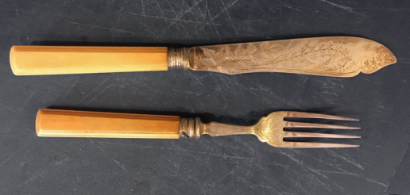
Click on to see the example associated with each picture.
Mary loves coloured pencils and pens. She is not particularly interested in drawing, but one of her great pleasures is sorting them by colour in their containers. Mary can get quite distressed if someone puts a pencil in the wrong place.
Jack has different cutlery for different kinds of foods. He takes his own cutlery with him, if he’s not eating at home. If the proper fork, knife or spoon is not available, he is unable to eat.
Simon succeeds in his Food Technology classes at school. In one class, he learned how to make a Victoria Sponge. His mum asked him to make the cake at home. The ingredients and equipment at home are not exactly the same, so Simon didn’t know how to.
Phil goes the same way to work every day. He knows how long each section of the journey takes, and he ticks them off in his mind as he completes them. If there is a road closure and he has to follow a diversion, he arrives at work very distressed and anxious. It takes him some time to be able to calm himself enough to start work.
Lucy has missed several important medical appointments, because she finds it difficult to keep track of dates.
Her friends and family think she’s uncaring, as she rarely remembers birthdays.

Slide 12
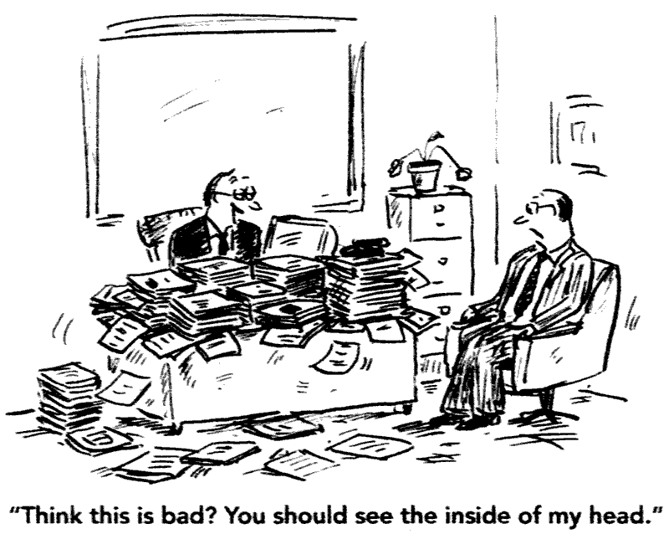
When addressing differences in social imagination, the diagnostic manuals refer to:
“restricted, repetitive patterns of behaviour, interests, or activities” (DSM_V)
“a pattern of repetitive, stereotyped behaviours and activities” (ICD-10)
On the previous slide, we saw some examples:
Mary lines up her coloured pencils, over and over again.
Jack is restricted in the type of cutlery he needs to use to be able to eat.
Phil needs to repeat the same journey to work every day, or he becomes stressed.
It’s important to realise that these behaviours aren’t random. They serve an important purpose for Autistic people.
We’ve seen before that for many Autistic people, the world is experienced as chaotic, unpredictable and overwhelming. Repetitive behaviours and routines can be a way of imposing order, seeking a sense of security, or getting comfort.
Now let’s look in more detail at three areas – routines, transitions and coping with change; repetitive behaviours; and intense interests,.

Slide 13
Routines, transitions and coping with change
As we saw in the Autism Aware module, we all have routines – particular ways that we like to do things that help us to feel “in control” or “on top of things”. Some people may like routines more than others, but we can all feel stressed or anxious if our routines are interrupted.
Let’s go back to the supermarket.
Imagine…
You go to your regular supermarket, and it’s had a refit. Everything has been moved around. The jam’s no longer near the bread, and the crisps aren’t near the chocolate any more. The freezers are now … somewhere else … and the café isn’t there anymore.
Think about how you might feel.
What might happen because of the change around?
You might have said that you feel annoyed, wound up, stressed or frustrated. Or perhaps, intrigued, interested or curious. You might feel the new layout makes no sense to you. Or more sense!
Some of the things that might happen are: your shopping takes much longer than you’d planned; you keep having to ask where things are; you aren’t able to find everything you want.
All these feelings and consequences are because you can’t carry out your normal shopping routine.

Slide 14
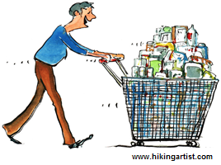
Neurotypical people are able to cope with changes to their routines, or with unexpected events, because they are able to imagine the consequences of the change – to imagine what is likely to happen next. Or they can see the context of the change, and understand that it affects only a part of an experience, not the whole thing.
Here are a couple of the ways that a neurotypical person will understand the changes at the supermarket. Click on to see how an Autistic person’s understanding and experience may be different.
Supermarkets refit regularly – and the changes don’t mean that they suddenly start selling car parts instead of food.
An Autistic person’s idea of “a supermarket” is likely to be constructed out of the details, rather than the “big picture”. Because the details have changed, the place no longer fits with their definition of “supermarket” – it’s something completely new, and unfamiliar.
If the fruit and veg isn’t the first thing that you see anymore, it will most likely have been moved to somewhere else in the store.
This understanding is linked to one of the key aspects of social imagination – being able to predict the future, based on past experience. An Autistic person may understand that if something is not in its usual place, it has gone completely.
It will be less stressful next time, because I’ll be used to the changes.
An Autistic person may not be able to predict this. Being able to be flexible and adapt to a new shopping routine may be a skill that they don’t have.

Slide 15
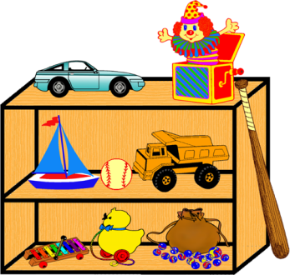
If an Autistic person is severely impacted by their differences in social imagination, a change to the smallest detail may mean that they experience something as completely unknown, that they don’t understand how to cope with. This can be very distressing.
Click on to see an explanation of how these two Autistic people may be experiencing change.
Jack’s parents bought new bedding for him, in the colours of his favourite football team. That night, Jack wouldn’t go to bed. He screamed and cried, and became distraught.
Jack’s understanding of “bed” is linked to the detail of the specific bedding that he used to have. The new bedding means that, for Jack, this is no longer the place that he goes to sleep.
On her way to bed, Lucy touches the wall by the stairs, the bannister, her bedroom door and her toy shelves. If she isn’t able to do this, she becomes very agitated and has to be taken downstairs to repeat the process from the start.
Lucy’s understanding of “going to bed” is linked to the details of her touching routine. If she doesn’t carry out the precise routine, she is doing something that isn’t “going to bed”. She doesn’t understand what it is that she is doing, and finds that very upsetting.

Slide 16
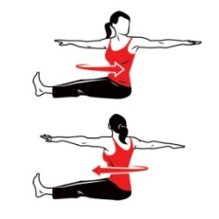
Think about the routines that you have.
Some common routines are:
Exercise.
Beauty.
Work.
Routines help us to:
Know what to expect or do next.
Do things in the right order.
Feel in control, and that the world is orderly
Remember all the elements of a task or activity.
Keep track of our progress towards our goals.
We just saw how distressed Lucy gets when her bedtime routine is changed. Autistic people who are less severely impacted by their social imagination differences can also be very reliant on routines to have this sense of order in their lives.
Here’s Cynthia Kim, an Autistic writer, talking about what her routines mean to her, on her website “Musings of an Aspie”
My routines have purpose. Without them…[t]he plants don’t get watered. The dog may or may not get fed. I forget to shower. I get anxious about what’s for lunch before I’ve even finished breakfast. I … just plain forget to do things … spend way too much energy on the blizzard of little choices that typical people find effortless and I find exhausting, never getting around to the more important stuff. I become all details and no big picture.

Slide 17
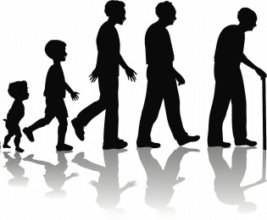
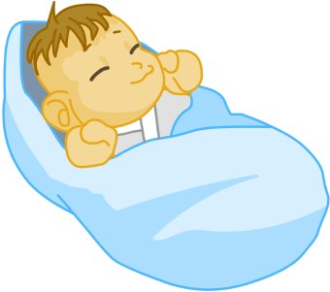
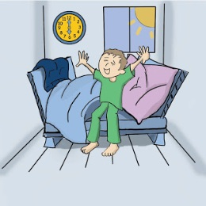
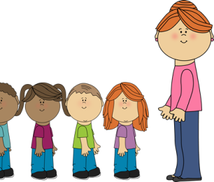
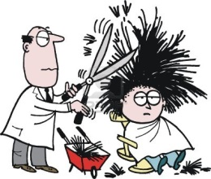
Transitions
A transition is a process of change from one state to another. Transitions can be:
Big, life changing events
Starting, or leaving, school
A bereavement
Changes to the body with puberty, or aging.
Becoming a parent
Or smaller, everyday changes
Getting up, or going to bed
Changing lessons, or coming in after break
Starting or completing an activity
Getting a haircut
Autistic people can find all kinds of transitions difficult to cope with. On the next slides, we’ll look at some strategies that can help to reduce the stress and anxiety associated with change.

Slide 18
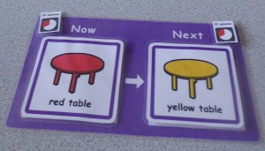
Click on to see examples related to the pictures.
Timetables, schedules and diaries are all important aids. A “Now and Next” visual timetable can help someone who has a lot of difficulty predicting what will happen next.
Go on a visit to a new place, so the person can familiarise themselves with it, before anything else is expected of them.
If you make appointments with someone, keep as much the same as possible every time: day, time, place.
Be reliable: don’t make changes to appointments unless it’s unavoidable. Recognise that it may be very stressful for someone if you do – even if they usually appear to cope well with appointments.
Use timers to give a visual cue as to when an activity is going to come to an end can help a person prepare for a change. These could be digital timers, sand timers, or countdown apps.
Provide as much clear and specific information as possible in advance.
An Autistic person may not make the same assumptions about appointments, procedures or events as neurotypical people do. Giving information can reduce uncertainty and anxiety.

Slide 19
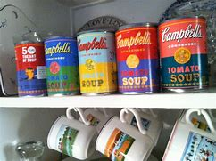
Repetitive behaviours
Just like routines, repetitive behaviours can provide a sense of calm and control. An individual may not use repetitive behaviours deliberately, or even be aware of them, but their stress and anxiety will increase if they are prevented from doing them.
Click on to see some examples of repetitive behaviours that Autistic people may display.
Earlier, we learned about Mary, who likes to sort and line up her coloured pencils. Here are two other examples.
Autistic people may attempt to keep order by counting things, either in their head or out loud.
They might count footsteps, cars passing, stirring motions, clocks ticking, those cans on the supermarket shelf…
A neurotypical child might build a house, a tower or a person from blocks. An Autistic child might, instead, always sort them by shape or colour.
An Autistic person may feel stressed if can labels aren’t all the same way, or cups aren’t paired.
They may need to stop to turn cans round in the supermarket.
Turning lights on and off, eating food in a specific order, wearing the same jumper every Thursday, pacing, always cleaning glasses before speaking to someone, or sitting in the same spot in the café are all examples of repetitive behaviours that Autistic people may exhibit.

Slide 20
Stimming
In the Autism Aware module, we saw a cartoon about stimming. As a reminder, stimming is short for “self-stimulatory” behaviour. It’s a very common type of repetitive behaviour, that increases a particular kind of sensory input.
Most people engage in some kind of stimming behaviours.
If you’ve ever tapped your feet because you need to control your impatience, doodled to help you listen to someone on the phone, or rocked backwards and forwards because you are upset, you have been stimming!
The purpose of stimming can vary from individual to individual, and can include:
Click on to see what this girl says about stimming.
Soothing or calming anxiety
Providing pleasure
Releasing energy or anxiety
Aiding focus and concentration
Distracting from negative emotions or experiences
If anything, stimming improves my concentration. It’s a release, like sneezing or scratching an itch. Have you ever tried to ignore an itch? What if someone told you it was wrong to scratch yourself to relieve an itch? What would that do for your concentration?
Autistic people may be more reliant on stimming behaviour to help them function on a day to day basis. They may also exhibit more unusual behaviours.
We’ll see some examples on the next page.

Slide 21
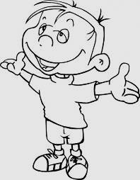
Click on to see examples of stimming behaviours that Autistic people may display.
Visual: staring at lights, or spinning objects
Flicking hands, fingers in front of eyes
Repetitive blinking or eye rolling.
Aural: listening to the same sound over and over (eg rewinding a song to hear the same line, repeatedly pressing the same button on a sound toy)
Making vocal sounds or tapping, snapping noises.
Taste / Smell: sniffing objects or people, holding objects close to nose
Licking or chewing on non-edible things
Tactile: rubbing, scratching, stroking, picking, “fiddling”
Can be objects or other parts of the body
Body awareness: rocking, swinging, jumping, pacing, spinning, tiptoeing
Unusual stimming behaviours can be uncomfortable for neurotypical people to witness. Because stimming behaviours can provide a critical coping strategy for Autistic people, it’s important that they aren’t just prevented from doing them. If a behaviour is unsafe for the Autistic person or those around them, it would be preferable to find an alternative stimming behaviour that fulfils the same need for the person.

Slide 22
Intense Interests
In the Social Communication and Interaction module, we looked at Autistic people’s conversational styles. We saw how for some people, their conversation can revolve around a particular interest.
Having intense interests is one of the characteristics that diagnosticians look for when deciding whether someone is Autistic or not. The diagnostic manual, DSM-V describes this characteristic as:
“highly restricted, fixated interests that are abnormal in intensity or focus”
Let’s have a closer look at what this means.

Slide 23
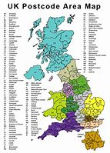
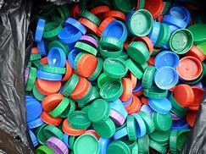
Sometimes, a person’s special interest can be unusual in subject, or very narrow and specific in focus.
Here are some examples:
Manual cash registers
Mid-12th century Cistercian monasteries
Postcodes
Milk bottle tops
Blue postage stamps
Cogwheels
The American Stock Market
Photographing doorways
People with intensely focussed interests may have extensive collections of objects, or an extreme interest in statistics about their subject.
Some people have an interest that lasts a lifetime. Others may have intense focus on one subject, and then lose all interest and move on to something else.

Slide 24
Other people can have interests that are more likely to be shared by others.
In this case, it’s the intensity that characterises it as an Autistic trait. Autistic people are unlikely to “have a passing interest” in a subject. Their interest tends to be all or nothing.
“If something catches my interest, I need to find out everything I can about it. Otherwise it’s like a piece of torn fabric, with rough edges that irritate and nag at me, and are ugly. I feel really insecure, as though the world will fall apart around me because of the tears and holes.
I need to “fix” the tears, the gaps in my knowledge, so that everything is whole and safe and beautiful again.”
Here’s Cynthia Kim, again, this time talking about one of her special interests, running,
“… when I took up running, I didn’t just go out and jog a few times a week. I read books about training for marathons. I found workout plans online and joined a training site to get personalized drills. I learned about Fartlek and track workouts and running technique. I signed up for road races. Ten years later, I spend more on running clothes and shoes than on everyday clothes. I use a heart rate monitor and a distance tracker to record my workouts. If I go on vacation, I pack all of running stuff. I don’t just like to run occasionally; running is an integral part of my life.”

Slide 25
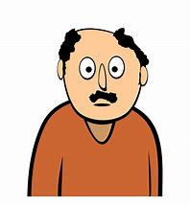
Having an intense special interest can cause problems for Autistic people. Click on to see an example.
Daniel is 24. His special interest is shoes. He is non-verbal, so he expresses his interest through his actions.
At home, he plays with his shoes and his parents’ shoes all the time. When visitors come, he’ll try to take their shoes and squirrel them away in his collection.
Out and about, he’ll run up to strangers and try to examine their shoes. He’ll want to stand and stare into shoe shop windows all day, and can become very distressed if his parents try to move him on.
Special interests can also have a positive impact on people’s lives. Click on to see how special interests enhance these people’s lives.
When I’m going through stress or life changes, I literally need my special interests to stay functional. … A special interest is a place I can control, where I can fully define the rules of play. It’s predictable, accessible and free from unwanted disturbances.
I turned my special interest into a successful academic career.
I joined my local history society, and I can spend time with people without worrying that I’m always boring them.

Slide 26
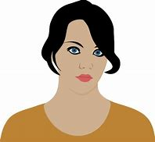
Girls and women
Historically, 3 in 4 people diagnosed with Autism have been male. Until recently, it was thought that Autism affected males more than females. Now though, it is recognised that some of the gap in diagnosis rates is because girls and women can have subtly different presentations of Autism, which can be more difficult to identify.
Click on to see some examples:
I tend to engage in more social interactions than boys.
Usually I’m led by others, rather than initiating social contact myself.
I’m more likely to be able to control my emotions and behaviour in social settings, such as at school.
I’m more likely to have my meltdowns in private than in public.
I engage in a lot more pretend play than boys my age.
My play tends not to be fluid, but to have elaborate, intricate rules that govern it.
I often make really intimate relationships with others. My friendships are based on a shared interest, or working with someone.
When the job or interest changes, I don’t know how to keep the friendships going, and I drift away from the people I’ve been close to.
I watch my peers closely and mimic their behaviour.
My understanding of social interactions appears to be much higher than it is.

Slide 27
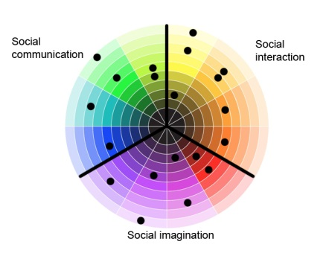
Getting it Right For Every Child
Getting it Right for Every Child (GIRFEC) is the Scottish Government’s approach to improving outcomes for children and young people. GIRFEC aims to make sure that everyone who supports children and young people has a consistent approach, and puts the child at the centre of all decision making.
We’ve noted throughout these modules that every Autistic person is unique: there is no straight-line scale from “mild” to “severe” that people can be placed on.
Autistic children and young people can be impacted in very different ways, and need very different kinds of support to achieve their potential.
Some students may need intensive 1:1 support in a specialist environment. Others may flourish in mainstream school with some understanding and accommodation of their specific sensory processing, communication or social imagination differences.
Even an Autistic student who appears to cope well with the school environment may find particular and very specific aspects of the school environment intolerable for them.
The GIRFEC approach means taking note of each child’s strengths and needs, responding to them as a unique individual, and providing them with the environment they need to achieve their potential.

Slide 28
One of the key GIRFEC tools is the SHANARRI indicators, which give a framework for assessing children and young people’s wellbeing..
Click the circles to see some of the barriers to achieving their potential that Autistic children and young people may experience in each area.
ACHIEVING:
Materials presented in ways that are not understood
Exclusions due to difficulty understanding classroom rules and etiquette
ACTIVE:
Difficulty understanding rules and interactions around activities
Difficulty with team activities
NURTURED:
Differences in expressing and perceiving relationships
RESPECTED:
Susceptible to bullying because of unusual behaviours.
HEALTHY:
Difficulty expressing emotions
Different experience of pain
Misunderstanding health advice
N
A
A
R
RESPONSIBLE:
Incorrect assumptions about capability based on communication style
H
R
INCLUDED:
Social opportunities not appropriate to communication and interaction style
Length of time required to develop relationships
SAFE:
Misunderstanding social norms or people’s intentions
Not understanding potential consequences of their actions
S
I

Slide 29
Strengths
Autistic people can face many challenges living in the neurotypical world, and we’ve tended to focus on these as we worked through the characteristics of Autism. Individuals can also have many strengths that can make them exceptional friends and employees. Here are some of them:
I make it my business to be very knowledgeable about my area.
I’m very loyal. I don’t play “head games” or take advantage of other people.
I am very good at work that requires attention to detail. I often spot things that other people have missed.
I’m conscientious, and my timekeeping is excellent.
Once I understand a task, I’ll carry it out accurately and reliably.
Because I see the world differently, I can often find innovative solutions to problems.
I’m often calm and objective in a crisis, because I don’t get carried away with the emotion..
I’m honest, direct and non-judgemental. I won’t say things that I don’t mean.
My ability to see logical sequences and my structured thinking can be very useful in planning and decision making.
I’m resourceful in overcoming challenges.

Slide 30
If you want to learn more, check out the last of the Autism Informed modules:
Autism Informed: Sensory Processing and Co-existing Conditions
A more in-depth look at the differences in sensory processing that many Autistic people experience.
A look at some of the common co-existing conditions.
Strategies to help mitigate sensory processing differences.
These are some useful websites:
Autism Network Scotland http://www.autismnetworkscotland.org.uk/
National Autistic Society http://www.autism.org.uk/
Scottish Autism http://www.scottishautism.org/
Autism Toolbox http://www.autismtoolbox.co.uk/
Scottish Government Autism Strategy http://www.autismstrategyscotland.org.uk/
The Welsh Government Autism information site: http://www.asdinfowales.co.uk/home/
Principles of Good Transitions 3, Autism Supplement https://scottishtransitions.org.uk/good-practice/principles-good-transitions-3-autism-supplement-autism-network-scotland/
If you click on the green link, the website will open in another window.

Slide 31
That’s the end of the Autism Informed: Social Imagination module.
Thank you
for taking the time to learn about Autism.
You can now close the slide show, by hitting the “Escape” button on your keyboard.

