Slide 1
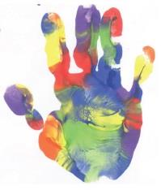
Scottish Borders Autism Strategy
Level 2e: Autism Informed
Sensory Processing &
Co-existing Conditions

Slide 2
Welcome to the fifth Autism Informed e-module.
This PowerPoint learning module is best viewed in Slide Show mode. If you are not currently viewing in this mode, you can switch by clicking on the “Slide Show” tab above, and then on “From Current Slide”.
Use your mouse, or the right arrow on your keyboard to move through the presentation. Some of the slides may have links to websites with video or more information. If you click on them, a webpage will open in a separate window.
At some points, you will be asked to reflect on your own experiences. You may wish to have a pen and paper to take notes of your responses.
The module should take approximately 30 minutes to complete.

Slide 3
This is the third of five Autism Informed modules. These modules build on the information and ideas contained in the Scottish Borders Autism Strategy: Autism Aware module, which you should complete first.
The Autism Informed modules will give you information and insight that will help you to understand and support Autistic people you know or work with. You might work in a role where you come across Autistic people from time to time. Or you may encounter people who respond to change in unexpected ways, or whose behaviours seem unusual to you, without you knowing whether they are Autistic. These modules will also give you a solid base to go on to further, specialist training if you work specifically with Autistic people.
All our modules have been created with advice and guidance from Autistic people, parents and carers from the Scottish Borders. Importantly, these modules have been designed to give you insight and empathy as to how Autistic people may experience the world, and the challenges they may face. Throughout the modules, we use the term “Autism” to include all Autistic Spectrum Conditions including Asperger’s Syndrome.
In this module, we will explore:
What is sensory processing?
What sensory processing differences may Autistic people have?
What other physical and mental health conditions do Autistic people commonly experience?

Slide 4
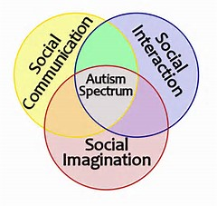
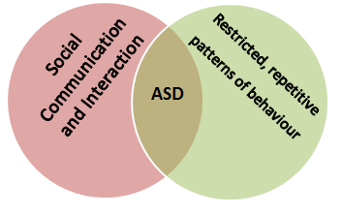
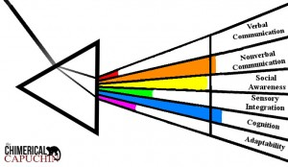
Introduction
In previous modules we saw that a diagnosis of an Autism Spectrum Disorder is based on identifying differences in the areas of Social Communication, Social Interaction and Social Imagination.
We saw how these are often described as either a Triad, or a Dyad, of difference. This depends whether Social Communication and Social Interaction are viewed as separate or connected areas.
We’ve explored some of the differences in these three areas. And we’ve seen how each person will have strengths and needs in these areas, depending on how much they are impacted by their differences.
The aspects we explore in this module are NOT part of an Autism diagnosis, but are commonly experienced by Autistic people.

Slide 5
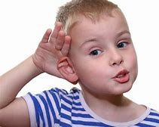
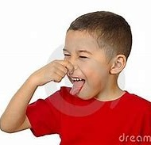
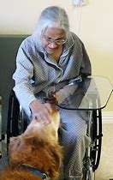
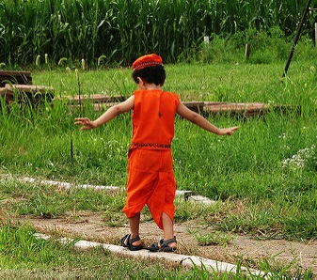
What is sensory processing?
You are probably very familiar with five of the senses.
Sight
Hearing
Taste
Smell
Touch
There are two other important senses that you might not be so familiar with.
Balance or “equilibrioception”
Body awareness or “proprioception”
Our sense of balance gives us information about the orientation of our body. Is it upright, horizontal, tilting? It tells us whether we are moving or still.
This gives us information about the position of our body, and body parts. It tells us where they are in relation to other parts of our body, and to objects around us.

Slide 6
We constantly get pieces of information about the world around us through our senses: smells, sounds, textures, tastes, sights and information about our body. A piece of sensory information is called a stimulus (plural stimuli). Our brains work to process these stimuli: to put them together and make sense of what we are experiencing.
There are five main stages to processing sensory information.
Click on to see more information about each stage.
Become aware
Shift focus
Make sense of the stimulus
Decide if response is needed
Respond
The brain registers that it is receiving information through the sense.
Attention is directed towards that stimulus.
The information is put together with other information from the environment and past experience (the context) to work out what is happening.
The decision about whether a response is needed is often unconscious – we aren’t aware of it.
A response, or reaction to a stimulus can be emotional as well as physical.

Slide 7
Let’s look at an example. You are about to leave the supermarket, when this happens.
Hover over the picture and press the play arrow.
Become aware
The brain registers that there is a new stimulus in the environment – a new sound.
Shift focus
You “zero in” on the sound. Other stimuli (the sound of people talking, checkouts, buzz of the lights) fade into the background, and you pay attention to the new stimulus.
Make sense of the stimulus
Your brain “matches” the stimulus with other sounds you have heard before, and you now know that it is a dog barking. You put this knowledge together with other information from your environment (you can’t see a dog) and work out that the dog is outside.
Part of your decision will be based on your previous experience with dogs. If it was bad, the sound might trigger the need for a fear or avoid response. If it was good, you it might trigger pleasure or approach responses. Ignoring the stimulus can also be a response. You are probably not aware of this decision making process.
Decide if response is needed
Respond
Your body enacts the chosen response. You might go to stroke the dog, or choose another exit, or walk past it without acknowledging it. Emotional reactions (fear, anxiety, pleasure) are also responses you might have.

Slide 8
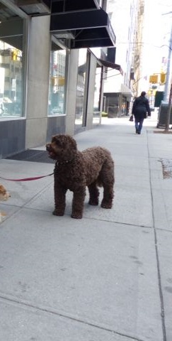
One of the key things that we have learned through these modules is that Autistic people process information differently to neurotypical people. This can affect the way that they process sensory information, as well as communication and interaction information. An Autistic person may have differences at any, or all, stages of sensory processing.
Click on for an example of a difference an Autistic person may have in processing the sound of the dog barking outside the supermarket at these stages of sensory processing.
Autistic people can experience hyperfocus: their attention is locked into one kind of sensory stimulus. Someone may be hyperfocused on the visual stimuli in the supermarket and not become aware of the sound of the dog barking.
Become aware
Shift focus
An Autistic person may experience every sensory stimulus as having equal weight, or importance. A neurotypical person would usually unconsciously consider a new stimulus as “important” and shift attention to it. An Autistic person may not do this.
The Autistic brain tends to focus on details, rather than the “big picture”. In our example, a neurotypical person will have developed a generalised idea of a “barking dog”, and match the sound to that. For an Autistic person, the sound of a small dog yapping and a big dog barking may be experienced as completely different, and no match made. An Autistic person may only recognise the kind of barking they have heard before as “barking”.
Make sense of the stimulus

Slide 9
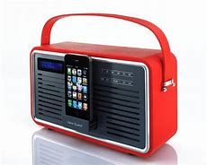
Hypo- and Hyper-sensitive
To feel comfortable, we need to have the right amount of sensory stimulation.
Like Goldilocks, we need things to be not too much, not too little, but just right.
Everyone has a different tolerance level for sensory stimulus. What is too much for one person might be too little for another.
Some people like really spicy food, others can’t cope with it.
Some people like the peace and quiet of the countryside, others the bright lights and bustle of the city.
Think of music playing very quietly in the background. One person might find it calming and relaxing. Another person might find it irritating, and want it to be turned off or up.

Slide 10
Think about how you feel when you have too much, or too little, sensory stimulus.
If you are a person who likes peace and quiet, how do you feel when it’s noisy?
If you’re a person who likes to have the TV or radio on all the time, how do you feel when it’s silent?
Too much, or too little, stimulus can make us feel irritable, uncomfortable, overwhelmed and wanting to escape the situation.
We might look to change the environment, to get the right balance of input.
Changing things, to get the right amount of stimulus is called “regulation”.
If we have too much stimulus, we look to regulate ourselves by decreasing it.
Too noisy? Turn down the music.
Too bright? Pull down the blinds.
If we have too little stimulus, we look to regulate ourselves by increasing it.
Boring meeting? Doodle.
Food tastes bland? Add salt, sauce or spices.
Notes:
Model answer – reveal all to end.

Slide 11
For many Autistic people, their experience of “too little” or “too much” sensory input can be extreme. They might be hyposensitive, or hypersensitive.
Hyposensitive / Undersensitive
Hypersensitive / Oversensitive
Needs a lot of sensory stimulus to become aware.
Comfortable with much more stimulus than average.
Aware of very slight or subtle stimuli.
Needs much less stimulus than average to feel comfortable.
Someone who is hyposensitive might:
Not notice things in their environment that other people notice.
Experience sensory stimuli as less pronounced than other people: duller, quieter, blander.
Seek out stimulation
Someone who is hypersensitive might:
Notice tiny details that others don’t.
Experience sensory stimuli as more pronounced than others: brighter, louder, smellier.
Avoid stimulation, or become distressed because of stimulation
People can have different sensitivity for different senses.
Someone might be hypersensitive to sound, and find noise difficult to manage. The same person might be hyposensitive to taste, and find all food bland unless it’s heavily spiced.
On the next pages, we’ll look at each of the seven senses, and see how someone with hypo- or hyper-sensitivity may be impacted.

Slide 12
Hyposensitive
Click on to see examples
Hypersensitive
Look intently at bright lights
Be fascinated by brightly coloured or shiny objects
Move fingers and hands in front of eyes
Touch their surroundings to orientate themselves
Dislike bright lights, especially fluorescent lighting
Dislike vivid colour and “busy” visual environment
Spot tiny details, like pieces of fluff on clothes
Sight
Be distressed by sudden or unpredictable sounds
Be distressed by sounds others don’t notice (eg electrical buzzing)
Cover ears or make repetitive noises to block out sounds
Be fascinated by differences in pronunciation (eg accents / languages)
Seek out sounds (eg placing ear next to fridge to hear the buzzing)
Like noisy places
Create sounds by, for example, tapping, making vocal sounds, crunching or tearing paper
Hearing
Dislike strong tasting foods
Find any food too strong, and gag or reject the food
Dislike particular food textures
Be very aware of subtle differences in flavours
Seek out strong flavours
Chew clothing, fingers, or hair.
Try to lick or eat inappropriate things, eg grass or faeces.
Taste
Notes:
Click on picture to reveal text to left and right.

Slide 13
Hyposensitive
Click on to see examples
Hypersensitive
Be unaware of even strong smells, including their own body odour.
Smell objects and people in their environment.
Be unable to tolerate certain smells – eg foods, laundry products or perfumes
Be very aware of subtle differences between smells
Smell
Have difficulty changing direction, or on uneven surfaces
Experience vertigo when spinning, running or jumping
Experience anxiety about feet leaving the ground
Be unable to ride a bike.
Seek out movement, particularly spinning, running and jumping.
Don’t get dizzy easily
Rock backwards and forwards, or in circles
Balance
Be floppy and lean against people, walls or furniture
Be clumsy, and tend to fall
Be unaware of their own body sensations, such as hunger, pain or needing the toilet.
Have difficulty with fine motor skills – eg holding small objects, writing
Experience high levels of pain from minor injuries or illness
Be clumsy
Hold body in unusual positions
Body Awareness

Slide 14
We haven’t yet looked at the sense of touch.
How do you think that someone with hyposensitivity to touch might be impacted?
What about someone who is hypersensitive to touch?
Reminder:
Hypo = under
Hyper = over
Touch
You might have said:
Hyposensitive:
Not notice sensations, such as heat, knocks, cuts, pain or injuries.
Seek out tactile (touch) sensation.
Like feeling pressure such as tight clothes or enclosed spaces.
Hypersensitive:
Experience touch as unpleasant or painful.
Dislike messy play.
Can’t tolerate the feel of particular clothes: fabrics, labels or seams.
Avoid wearing shoes or socks.

Slide 15
Take a look at this everyday scene. We’ve thought before about how having differences in social imagination might impact on a trip to the supermarket.
Now think about differences in sensory processing.
What might people who are over- or under-sensitive to sensory stimulation find difficult in this situation? Remember to consider all seven senses.
Here are some you might have picked out:
Bright or flickering lights;
vivid colours;
strong smells of food, or people’s perfumes;
balance, when reaching up or down for items on shelves;
noise from people, fridges, squeaky trolley wheels, unexpected tannoy announcements;
bumping into people.
A busy supermarket is full of sensory stimuli, that can make it a challenging environment for someone with sensory processing differences. You may have thought of others.
Notes:
Model answer – reveal from “A busy supermarket…” to end.

Slide 16
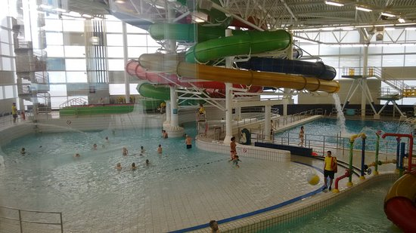
Someone who is hypo- or hypersensitive to sensory stimulus can find everyday environments, like the supermarket, distressing. Making changes to the environment to reduce the amount of sensory stimulus can help Autistic people, or people with other sensory processing differences.
Using subdued or natural lighting, reducing background noise, getting rid of visual “clutter” and avoiding strong scents are all simple ways to make an environment less challenging for people with sensory processing differences.
Here are some of the changes made at a swimming pool in Dundee to make the environment more “Autism friendly”.
•Televisions at Reception will be turned off
•Hand dryers in our toilet areas will be switched off
•Wave machine will be switched off
•Wave Jets will be switched off
•Cannonball flume will be switched off
•Toddlers Pool water features will be reduced
•Music will be turned off
•Public announcements will only be made if absolutely necessary

Slide 17
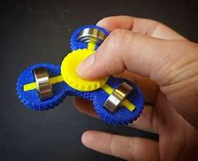
Some people may use personal aids in order to achieve the kind of balance that will allow them to feel comfortable.
Click on to see some of the ways people might manage their sensory differences.
People who are oversensitive to noise might use ear defenders to block out the sounds around them.
Or they might play music , white noise or ambient sounds through headphones to distract from noise in their environment.
People oversensitive to bright lights may wear tinted lenses all the time.
Someone who is undersensitive in their body awareness may like to wear tight clothes to give them a sense of where their body ends.
People who are undersensitive to touch might use fidget toys, or carry something tactile like plasticine with them.
Using personal aids can accentuate someone’s differences, so where possible, changing the environment is preferable.

Slide 18
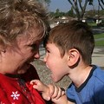
Sensory processing differences can be a trigger for meltdowns or shutdowns. Where an Autistic person has significant communication difficulties, identifying and solving the problem can be challenging. Let’s look at Ben’s story.
Ben is 6, and attends a mainstream Primary School, where he has 1:1 support from Peter and Sarah. He has limited verbal communication, but usually copes well in the classroom. Sometimes, Ben has significant meltdowns, and his behaviour becomes challenging.
School staff noticed that there was a pattern to this. His meltdowns generally happened after lunch on a Wednesday and Friday. They wondered if Ben didn’t like Peter, as these were the afternoons Peter worked with him. But Ben was happy with Peter in the mornings, just not on a Wednesday and Friday afternoon.
Ben’s teacher and support staff had worked really hard to try to identify why this was. They had made changes to his routine and to the environment in the classroom, but nothing seemed to make a difference.
Ben’s support staff started to look closely at what was different about Wednesday and Friday afternoons. Eventually, they realised that Peter always had a cup of strong coffee at lunchtime, whereas Sarah didn’t drink coffee at all. It was the smell of coffee on Peter’s breath that was distressing to Ben.
Peter stopped drinking coffee on the days he worked with Ben in the afternoons, and Ben’s pattern of regular meltdowns stopped.

Slide 19
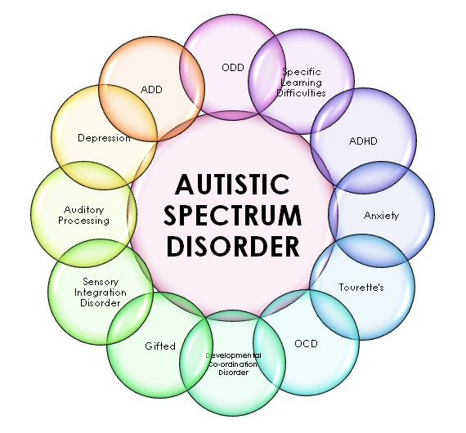
Co-existing conditions
Autistic people may experience other physical, emotional or psychological health challenges alongside Autism Spectrum Disorder. You may also hear these called “co-existing”, “co-occuring”, or “comorbid” conditions.
Sometimes, these conditions are diagnosed before the Autism diagnosis, sometimes afterwards, and sometimes at the same time.
Each condition needs to be diagnosed separately, and comes with needs and challenges that are distinct from those of Autism.
Autism can make diagnosis of other conditions complicated. The characteristics of Autism can overlap with the characteristics of other conditions, or the individual may have difficulty in communicating their symptoms in a way that others can understand.
https://www.dealwithautism.com/9-co-existing-disorders-with-autism-in-children/
On the next pages we’ll look at some of the most common co-existing conditions. In each section, click on to reveal information about the condition.

Slide 20
There are some conditions that Autistic people appear to be more likely to experience than neurotypical people.
The most common is for Autistic people to have a co-existing Learning Disability
A Learning Disability is diagnosed based on an individual’s IQ (70 or less) and their adaptive functioning: their ability to learn and carry out self-care and other skills required to live without support.
Learning Disabilities can be mild, moderate or severe.
Autistic people who also have a Learning Disability tend to be more severely impacted by their differences in social communication, interaction and imagination. Those who have a severe Learning Disability are more likely to have:
very little speech, or to make unusual vocal noises
Food refusal or very strong likes and dislikes
Self-injury behaviours, such as hand biting, head banging or skin picking
Increased anxiety, difficulty with transitions and attention difficulty
Autistic people with a Learning Disability are likely to require specialist education services, and additional support services in adulthood.
The most recent research for the Scottish Government suggests that approximately 32% of Autistic people also have a Learning Disability, compared to about 1% of the general population.

Slide 21
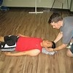
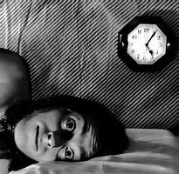
Autistic people are more likely to have Epilepsy
Epilepsy is characterised by seizures, that can result in:
Short blackouts
Convulsions (uncontrollable shaking or unusual movements)
“Absences” or staring into space
Epilepsy is treated with medication. Sometimes, characteristic behaviours associated with Autism (repetitive movements or intense focus) can look like Epilepsy, so careful diagnosis is required.
Between 20 and 40% of Autistic people have epilepsy, compared to 1% of neurotypical people.
Sleep Disorders Many Autistic people, particularly children, have difficulty with sleep.
Common issues include:
difficulty falling to sleep
difficulty waking up once asleep and
disturbed sleep, sleep walking or night terrors
It is unclear why Autistic people are more prone to problems with sleep. It may be that the Autistic brain produces melatonin (the sleep hormone) differently, heightened sensitivity to stimuli or not recognising the social cues that tell the body it’s time to sleep.
Poor sleep can result in hyperactivity, lack of attention or focus and irritability. These added stresses can make it more difficult to manage the challenges associated with Autism.

Slide 22
Fragile X syndrome is a learning disability, caused by a genetic mutation.
Some people with the mutation will have symptoms, others will be unaware that they carry the mutation. Fragile X syndrome is an inherited condition: it can be passed from parent to child.
Fragile X syndrome results in similar difficulties to those experienced by Autistic people, including:
Delayed speech and language
Social communication and interaction differences
Need for routine
Repetitive speech and movements
Unlike Autism, Fragile X syndrome is diagnosed by a blood test. About 1:4000 boys, and 1:6000 girls in the total population have Fragile X syndrome.
Approximately 30% of people with Fragile X will meet the criteria for a diagnosis of Autism. About 5% of Autistic people also have Fragile X syndrome.
Gastrointestinal, or Digestion problems appear to be common for Autistic people.
Problems can include:
Food intolerances, or allergies
Stomach pains, bloating, diarrhoea or constipation
It’s unclear whether these symptoms result from an underlying physical problem. Some Autistic people have restricted diets because they cannot tolerate certain tastes or textures. This might cause digestion problems.

Slide 23
Sometimes the characteristics of Autism can overlap with other conditions. Where the shared characteristics are strong enough, someone may get a specific diagnosis for the other condition.
Like Autism ADHD (Attention Deficit Hyperactivity Disorder) is a neurodevelopmental disorder that begins in childhood.
There are three main characteristics of ADHD:
Difficulties with Attention: eg not listening, making careless mistakes, having difficulty maintaining focus, being easily distracted.
Hyperactivity: eg being fidgety, restless, talking excessively.
Being impulsive: eg shouting out, difficulty taking turns or waiting.
People with ADHD exhibit behaviours not expected from someone at their stage of development.
All Autistic people are likely to have these characteristic behaviours to some degree. Where they impact daily life severely, a diagnosis of ADHD may be helpful. ADHD can be treated with medication or psychological interventions such as CBT.

Slide 24
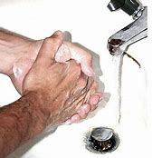
Sensory Processing Disorder (SPD) is characterized by differences in processing sensory stimuli.
We’ve seen how it’s common for Autistic people to have differences in the way that they process and experience sensory stimuli. People who have similar differences, without the characteristics of Autism, may be diagnosed with SPD.
SPD
Autism
It’s good practice for sensory differences to be recognised for all Autistic people. For someone who is particularly affected by their sensory processing differences, a secondary diagnosis of SPD may be useful in getting the right help and support.
Most Autistic people also have some degree of SPD. But most people with SPD are not also Autistic.
Obsessive Compulsive Disorder (OCD) is an anxiety disorder. OCD is characterized by obsessive thoughts and compulsive behaviours which are distressing.
An example that you may be familiar with is someone who has obsessive thoughts about germs, and washes their hands constantly because of these thoughts. Their OCD gets in the way of day to day life, as they need to be near a sink all the time. Even when they are aware that their compulsive hand washing is making their hands sore, they are unable to stop.
All Autistic people will exhibit some repetitive behaviours. It can be difficult to distinguish between OCD and typical Autistic behaviours. Usually, repetitive behaviours are calming and enjoyable for an Autistic person. If the repetitive behaviours are distressing, they might receive a diagnosis of OCD. OCD can be treated with medication or with psychological therapies such as CBT.

Slide 25
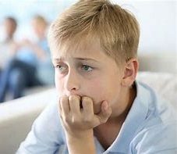
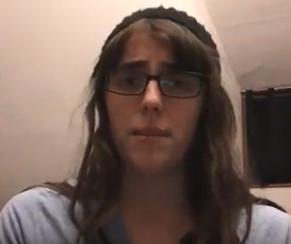
Autistic people are more at risk of poor mental health than the general population.
Anxiety is feeling worried, afraid or nervous.
Almost everyone feels like this at times: it’s a natural response to something threatening or challenging, like a job interview, meeting new people, or learning to drive. There are physical symptoms to anxiety, such as rapid breathing, sweaty palms, feeling lightheaded, thumping heart or shaking. For most people, anxiety is related to specific situations, and passes quickly.
Autistic people may experience more anxiety because their social communication, interaction and imagination differences make situations more challenging for them.
Or they may have difficulty processing the emotions, which makes them last longer.
Click on the picture to the right, to see an Autistic girl talking about her understanding of Autism and Anxiety. The video will open in another window.
Sometimes, anxiety can get in the way of a person’s everyday life. It might be that the anxiety lasts for a long time, their worries are out of proportion to the situation, or they have very strong physical symptoms, including panic attacks. Someone experiencing this level difficulty may be diagnosed with an anxiety disorder. Anxiety disorders can be treated with medication or psychological interventions such as CBT.
At any one time, about 40% of Autistic people will experience an anxiety disorder.
Notes:
https://www.youtube.com/watch?v=Oc-Kz3Luszs

Slide 26
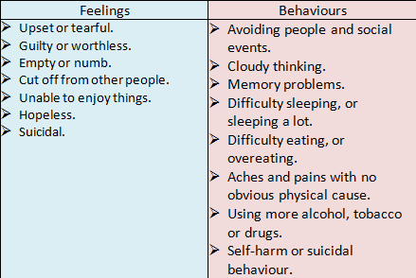
Depression is a feeling of low mood, numbness or hopelessness that lasts for an extended period of time.
Like feeling anxious, everyone has times in their life when they feel low or “blue”. These might be related to life events, such as bereavement, being bullied, moving house or changing jobs. Low mood can also be related to physical health problems, or certain medications.
When a period of low mood lasts for a long time, or doesn’t appear to be related to anything specific, someone may be diagnosed with depression.
Everyone’s experience of depression will be different, but there are some common signs and symptoms.
Difficulty with social communication and interaction can make Autistic people vulnerable to depression.
Autistic people may find it difficult to recognise and describe their feelings. This can make it challenging for them to seek and receive the right support.
As well as these common co-existing conditions, Autistic people can experience all the same physical and mental health problems as neurotypical people.
Attending medical appointments or describing symptoms can be challenging for Autistic people, and leave them vulnerable to not receiving the right treatment at the right time.

Slide 27
We’re going to finish our Autism Informed modules with a video by Autistic self-advocate and speaker George Watts. George asked local Autistic people in Kent to send in photos in response to the question “What makes you happy?”. Her video challenges some of the stereotypes of Autistic people, and gives a glimpse into the richness and variety of their lives.
Click on the image to open the video in another tab.
Notes:
https://www.youtube.com/watch?v=Rg62Fp6RUZs

Slide 28
If you want to learn more, these are some useful websites:
Autism Network Scotland http://www.autismnetworkscotland.org.uk/
National Autistic Society http://www.autism.org.uk/
Scottish Autism http://www.scottishautism.org/
Autism Toolbox http://www.autismtoolbox.co.uk/
Scottish Government Autism Strategy http://www.autismstrategyscotland.org.uk/
The Welsh Government Autism information site: http://www.asdinfowales.co.uk/home/
Monique Botha TED talk https://www.youtube.com/watch?v=NCAErePScO0
Cynthia Kim’s blog https://musingsofanaspie.com
The Little Black Duck https://www.thelittleblackduck.com.au
The Girl with the Curly Hair project https://thegirlwiththecurlyhair.co.uk
NHS web resource for GPs and primary care practitioners http://asd.nes.scot.nhs.uk/
If you click on the green link, the website will open in another window.

Slide 29
That’s the end of all our Autism Informed modules.
Thank you
for taking the time to learn about Autism.
You can now close the slide show, by hitting the “Escape” button on your keyboard.

