Slide 1


Scottish Borders Autism Strategy
Autism Awareness
Level 1

Slide 2

Welcome to the Autism Aware e-module.
This PowerPoint learning module is best viewed in Slide Show mode. If you are not currently viewing in this mode, you can switch by clicking on the “Slide Show” tab above, and then on “From Current Slide”.
Use your mouse, or the right arrow on your keyboard to move through the presentation. Some of the slides may have links to websites with video or more information. If you click on them, a webpage will open in a separate window.
At some points, you will be asked to reflect on your own experiences. You may wish to have a pen and paper to take notes of your responses.
The module should take approximately 30 minutes to complete.

Slide 3
This is the first of a series of learning modules on Autism.
Autism Aware is suitable for anyone with an interest in learning more about Autism. You may have a job which involves interacting with members of the public, some of whom may be Autistic, or you may have a family member, friend or colleague who is Autistic.
The modules have been created with advice and guidance from Autistic people, parents and carers from the Scottish Borders. You will learn some information about Autism. Perhaps more importantly, the modules have been designed to give you insight and empathy as to how Autistic people may experience the world, and the challenges they may face.
In this module, we will explore:
  The language we use to speak about Autism
  What is Autism?
  What are the challenges faced by Autistic people?
  Some of the common myths about Autism
  Simple ways to make a difference for Autistic people

Slide 4
First: Some words about language
The language we use to speak about something is important. The words we use convey complex ideas about the value we place on it, and its relationship to other ideas.
Autism is formally known as “Autism Spectrum Disorder”. However, this is now seen as problematic by the many in the Autism community. Take a minute to think about why that might be.
Then click to reveal some thoughts we had.
Terming something a “disorder” suggests that there is a correct way for people’s brains to work, and that an Autistic person is therefore “wrong”, needs fixing, or sorting out.
In these modules we want to celebrate neurodiversity – the fact that people have a wide range of thinking and learning styles, and different ways of experiencing the world. Many people use the terms “Autism Spectrum Condition”, or simply “Autism” to better express this. These are the terms we will use..
On the next page, we’ll look at the language we use to speak about individuals

Slide 5
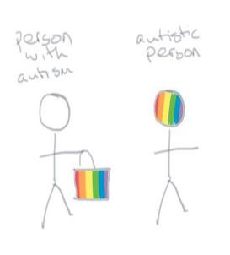
In general, we tend to use “person first” language to speak about individuals. We would say “person with Down’s Syndrome”, or “person with Cerebral Palsy”. This language is seen to emphasis a person’s equal rights, value, and worth as an individual. Recent research shows, however, that the Autism community tends to prefer “condition first” language: “Autistic person”, rather than “person with Autism”.
Click on to see why:
Firstly, English is an adjective-first language. We wouldn’t speak of “a person who is tall”, or “a woman with intelligence” but a “tall person” and “an intelligent woman”. So to use condition first language places Autism in line with other descriptive words about an individual: she is “a tall, intelligent, Autistic woman”.
Secondly, using person first language implies that Autism can be set aside, removed from the person. It suggests that Autism is “an unfortunate characteristic” that is not a part of the person’s intrinsic worth. Autism can’t be separated from a person, just as skin colour can’t. Using “condition first” language points to the value of the person’s different experiences and understanding of the world around them.
Origin unknown
It’s important to recognise that people have different opinions about this and to be sensitive to the way an individual describes themselves.

Slide 6
Let’s try a thought experiment.
Imagine:
You get a text on a Sunday evening, saying you’ve had a compulsory transfer to a new job starting the following morning. You turn up the first morning, sign in, are told to “sit where you like”, and that’s it... You don’t get any induction; you’re not given a job description. The environment is completely different to what you are used to.
You keep being told “ask for help if you are stuck”… but you don’t even know what you might be stuck with, you don’t know who to ask. Everyone seems really busy and unapproachable. Everyone seems to know what they're doing but you, nobody seems to accept that you don't, they just get irritated with you.
Think about how you feel, and what you might do.
You might want to write down your thoughts.

Slide 7
This scenario is an attempt of one Autistic person to give some insight into their day to day life.
Everyone has a different response to these questions.
You might have described feelings like “lost, frustrated, angry, anxious, lonely, inadequate” or “determined, curious, excited”.
You might have thought you would “go home; shout at people until you get their attention; copy what you see others doing and hope for the best; make up your own job description and do that”.
As you go through the module, learning about what Autism is, and how it may impact on a person’s experience and understanding, try to relate back to your responses to this thought experiment. Remember how you felt in this scenario.

Slide 8
What is Autism?
Autism is a lifelong, neuro-developmental condition which affects the way that a person experiences the world around them and communicates with others.
Autism is not an illness, or a disease that can be cured. Nor is it something that people “grow out of”. It is not caused by poor parenting or vaccines, and can’t be diagnosed by a blood-test or simple examination.
Autism is estimated to affect between 1 and 1.5% of the UK population. This is roughly 700,000 people in the UK, and about the same number of people who:
Have red hair
Use a wheelchair
Have green eyes
Autism is often referred to as a “hidden impairment” or “invisible disability”. It’s not a characteristic that is immediately obvious to others, unlike someone having red hair or using a wheelchair.

Slide 9
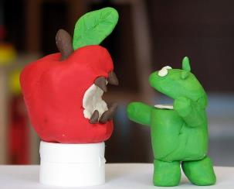
There are lots of different theories that attempt to explain the differences between Autistic and neurotypical brains.
“Neurotypical” means: thinking, perceiving and behaving like the majority of the general population.
We explore some of these theories in the Autism Informed modules. For now, let’s look at one of the most recent attempts.
Recent thinking suggests that Autism may be a difference in the way that the brain processes information.
You might think of it a bit like different computer, or mobile processing systems. It’s difficult to get a MAC and a PC to interact with each other. You need a different version of apps for an iPhone and an Android phone.
This is because they process information differently. Neither is right or wrong.
Both have advantages and disadvantages. They are just different .
Image by Tsahi Levent-Levi

Slide 10
It is thought that the neurotypical brain quickly scans all available information looking for patterns and links. It has a lot of filters which block out information it considers irrelevant, and then makes “best guess” decisions. A piece of information is given meaning by its place in this web of patterns and links – by its context.
Think of the phrase “hang up”. It can have many different meanings, depending on the context. How many can you think of?
You might have thought of:
Putting a picture on the wall
Putting the phone down
Putting a coat on a coat hook
Putting wet laundry on the washing line
Or someone’s emotional blocks or inhibitions
A neurotypical person’s brain sorts through all the information around them to understand which meaning the phrase has: things like where they are, what they are doing and what other people are doing. This happens automatically, without consciously being aware of it.
It’s thought that the autistic brain doesn’t perceive or understand context well. The autistic brain processes each piece of information separately, and gives one meaning to one piece of information. Rather than changing with context, each piece of information stands alone, and has its own fixed meaning.
Click on to the next page to look at another everyday example.

Slide 11
We all know that this means STOP!
……Don’t we?
But what if you are halfway across the road?
Then it means the opposite – it means HURRY UP!
And what if you have just stepped off the pavement?
Then it means GO BACK!
The CONTEXT – where you are - means that the red man sign can have different, contradictory meanings, needing a different response.
In the film Rain Man, there is a famous scene where the sign changes from “Walk” to “Don’t Walk” as Raymond is half-way across the road. He stops, and refuses to move, even when drivers are threatening him.
For Raymond’s Autistic brain, the “Don’t Walk” sign always means “Don’t Walk”. His brain doesn’t process the context, and isn’t flexible in interpreting the information. He isn’t able to change his behaviour to adapt to the different meaning the sign has when he’s in the middle of the road.
If you are interested, you can read more about how this example illustrates the challenges that Autistic people have in navigating a world where meaning is flexible and constantly changing here:

Slide 12
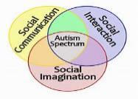
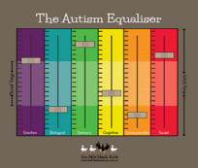
How is Autism diagnosed?
In the UK, best practice guidelines indicate that diagnosis should be carried out by a team of people from a range of professions (eg, nursing, psychology, speech and language therapy, social work or education). Diagnosis is based on discussion with the person and their family or carers; observations and a history of the person’s childhood development.
Professionals are looking for the characteristics of Autism Spectrum Condition, which are contained within diagnostic manuals used by all medical practitioners. For someone to be diagnosed as Autistic, they need to have differences in all three of the areas shown in the diagram to the left. We’ll look at these in more detail in the next section
Diagnosis is complex, partly because Autism is a Spectrum Condition. Whilst every Autistic person will have differences in social communication, interaction and imagination, the extent that someone is impacted by these differences will vary:
From individual to individual.
In different situations.
At different times of life.
This means that each person has a different profile of needs and preferences, and may need very different levels of support in different areas of life.

Slide 13
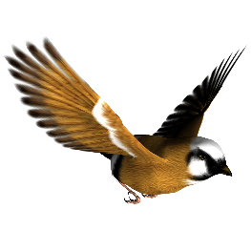
MYTH: Because Autism is a spectrum, someone can be “a bit autistic”.
FACT: No. A person is, or isn’t, Autistic.
Autism doesn’t exist on a scale from “mild” to “severe”. The term “Spectrum” isn’t related to high or low intelligence, to verbal ability, or to challenging behaviour. It points to the complex way in which Autism impacts on people’s lives.
Matthew Day, of Autism Initiatives Scotland, gives this analogy:
To be a bird a species has to have six characteristics: feathers;
wings; two legs; lay eggs; backbone and warm-blooded.
A human has two legs and a backbone, but isn’t “a little bit bird”.
A creature either is, or isn’t a bird.
Same with Autism.
People can be impacted to more severe ways by some or all aspects of being autistic. Some people may face little challenge in some aspects of life, and huge challenge in other aspects. Some people may face huge challenge in all aspects, which may be heightened by additional Learning Disability or Mental Health issues.
Now let’s look in more detail at the characteristics of Autism.

Slide 14
Social Communication
MYTH: Autistic people don’t want to communicate.
FACT: Autistic people may communicate in different ways. The differences they have can make communication stressful and difficult for them.
Social communication means sharing information with other people through the use of language.
In everyday communication we use different types of language:
    Spoken – including words and tone of voice
    Pictorial – including images and symbols
    Body language – including gestures, facial expressions and posture
    Written – including words, fonts and layout
Our communications are a complex interaction of these different languages.
Changes in tone of voice and body language can make the same words mean opposite things. “That’s just perfect” could mean that it is exactly what was required, or that it is a complete disaster.

Slide 15
Look at the following sentences, and explore how simply changing the word that is stressed changes the meaning:
She didn’t mean to break the plate.
SHE didn’t mean to break the plate.
She DIDN’T mean to break the plate.
She didn’t MEAN to break the plate.
She didn’t mean to BREAK the plate.
She didn’t mean to break THE PLATE.
(But someone else did…)
(A response to an accusation that her action was deliberate.)
(It was accidental.)
(She just meant to throw it at you.)
(She meant to break the window she threw it at.)
Autistic people can have difficulty in sorting through this complex web of communication, which can affect the way they use language. (Remember what we discussed before about context?)
Sometimes this can lead to Autistic people having difficulty with metaphorical or symbolic language. They can understand language literally.
For example, “I’ll kill you if you do that again” could be understood as a concrete threat, rather than an expression of frustration.

Slide 16
People can have a range of ability from:
Non-verbal -------------------------------------------------------------highly developed vocabulary
Often, verbal ability doesn’t match understanding.
For example, someone might:
have an extensive vocabulary, but use words in unusual ways, have very literal understanding of language, or be unable to decode the tone of voice or body language of the person they are communicating with. This can lead to misunderstandings in both directions.
not speak, but use written or pictorial communication to convey deep understanding.
require a long processing time to sort through all the different pieces of information contained within a communication, before they can conclude how to respond. They may appear to have less understanding than they do.
Some Autistic people may prefer, or need, to use written, pictorial or sign language, rather than verbal communication. Some people may use an augmented communication device, a laptop, or an app to communicate. Others may be verbal when calm, but non-verbal when stressed.

Slide 17
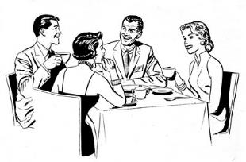
Social Interaction
MYTH: Autistic people are all loners who don’t want to be involved in social activities.
FACT: Some autistic people are loners, just like some neuro-typical people are. Most want to have friends and be involved in social situations, but can find these confusing and are not sure how to.
Differences in social interaction are closely tied in with the differences in social communication that we have just explored. There can be no communication without interaction, and no interaction without communication. We’ve seen how communication is a complex web of verbal and non-verbal information, and how this can be difficult for autistic people to navigate.
When it comes to social interactions with others, yet more information is added to this mix, and the CONTEXT becomes more important.

Slide 18

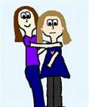
Before you greet someone, you need to understand the context – to have the answers to a whole raft of questions, such as:
Think about greeting someone. What would you say, and do?
Most likely, you answered with something along the lines of “it depends who it is…”.
Have I met them before? Where and when?
Where are we? In public at a formal meeting or event? In private? At work?
What’s our relationship? Are they family, friend, colleague, boss…? Do we like each other or not?
Who else is here, and what do I want them to know about our relationship? What does the other person want them to know?
Are there any cultural rules I need to follow?
The answers to these, and more, questions determine what would be viewed as socially appropriate behaviour. There are different ways of greeting a close friend on a night out, to greeting the same friend at a formal business meeting. Getting it wrong can leave you, and the other person feeling awkward or embarrassed.
For neurotypical people, this thinking and decision-making happens automatically. Usually, the right decision for the context is made instinctively. For autistic people, all these questions and options may need to be processed individually, particularly in new or ambiguous situations, or with new people.
On the next page, you can see what saying “hello” might seem like to an Autistic person.

Slide 19
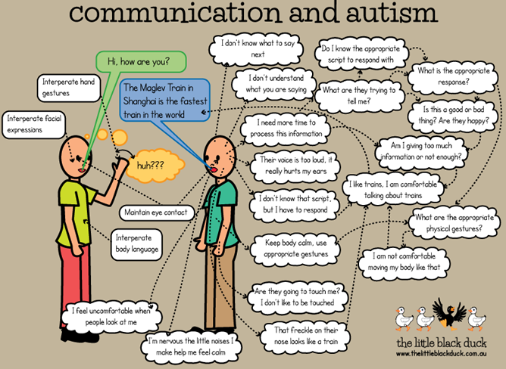

Slide 20

For neuro-typical people, the ability to adapt behaviour to context is usually learned through being taught basic rules and adapting them by imitating others, and picking up on subtle clues of the approval or disapproval of those around us. It becomes so rapid that it’s generally undetectable.
It is unusual to be taught explicitly for each different situation, unless there are formal or ritualistic rules surrounding the interaction.
For example, if you were to meet the Queen, an aide would brief you regarding the correct etiquette beforehand.
Because of the difficulty the autistic brain has in identifying and processing context it can be harder for Autistic people to generalise social rules and adapt them for new situations.
For many Autistic people, settings that are highly structured and predictable are usually easier to manage, because the rules for interacting with others are more explicitly communicated.
Many autistic people thrive in the Forces, where there are strict rules about what to wear and how to act, and clear daily routines.
Drama can be attractive, because there is a predictable script to follow, and time to be guided in and practice tone of voice, facial expression and body language.
Now let’s look at the third element of the Triad, Social Imagination.

Slide 21
Social Imagination
MYTH: Autistic people have no imagination.
FACT: Autistic people can be very imaginative, but may not express this in the same way as neurotypical people.
Imagination is about being able to step outside a situation, and explore what we can’t see, hear, smell, taste or touch in our immediate environment.
Imagination is created from memory:
    by recreating memory in whole (for example by imagining the last cake you ate) or
    by putting pieces of memories together in different ways and contexts (for example by imagining what you will have for dinner tonight).
Often we think of imagination as being to do with writing fiction, creating amazing art, making a new kind of vacuum cleaner, or pretend play. However
We use imagination in a whole range of social processes, not just in the arts or inventing.
It is in this area of social imagination that Autistic people can have difficulties. The use of the word “context” may have alerted you to this!

Slide 22
•
Social imagination is used in planning; organising; understanding language; managing change; understanding past, present and future; problem solving; and relating to others.
Social imagination allows us to understand other people’s reactions and behaviours; cope in new and unfamiliar situations; and predict what may happen in the future.
Having difficulties with social imagination means Autistic people can experience the world as chaotic, confusing and out of their control. To cope with this, people may rely on routines, use repetitive behaviours, or have restricted interests.
Think about a routine you have. It might be a morning or evening routine, a particular way to work, a way of doing the dishes or working your way around the supermarket. How do you feel when your routine is interrupted?
You might have said “stressed”, “anxious”, “put wrong for the day” or “uncomfortable”, depending on what example you thought of.
We all use routines to help us feel comfortable and in control of our world. For Autistic people, routines can be critical, and the slightest change can lead to a feeling of being overwhelmed and fearful.

Slide 23
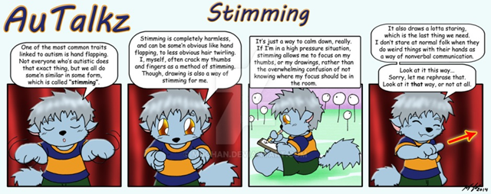
Many Autistic people use repetitive behaviours (known as “stimming”) to cope when feeling overwhelmed.
We all use repetitive behaviours in some way – eg pacing up and down or tapping your feet whilst waiting for important news. Autistic people can show more unusual behaviours, such as hand-flapping, hair twirling, rocking, vocalising or fiddling with an object.
Stimming is completely harmless, and can be some’n obvious like hand flapping, to less obvious hair twirling. I, myself, often crack my thumbs and fingers as a method of stimming.
Though, drawing is also a way of stimming for me.
It’s just a way to calm down, really. If I’m in a high pressure situation, stimming allows me to focus on my thumbs, or my drawings, rather than the overwhelming confusion of not knowing where my focus should be in the room.
It also draws a lotta staring, which is the last thing we need. I don’t stare at normal folk when they do weird things with their hands as a way of nonverbal communication.
One of the most common traits linked to autism is hand flapping. Not everyone who’s autistic does that exact thing, but we all do some’n similar in some form, which is called “stimming”.
Look at it this way…
Sorry, let me rephrase that. Look at it that way, or not at all.
These stimming behaviours are a healthy way to relieve stress, and only need intervention if they are causing harm to the individual or others.
Stimming can also be linked to sensory differences (we’ll look at those later), or boredom.

Slide 24
A special interest can:
Be essential to supporting someone’s wellbeing and happiness
Provide structure, predictability and order to daily life
Help someone to feel more confident in starting conversations.
Special interests can help Autistic people to find social groups, and build friendships. They can also be problematic in social interactions, as Autistic people can find it difficult to recognise that other people are not always as interested in the subject as they are.
Many Autistic people have intense, restricted interests. These can last a lifetime, or change over time, but are generally characterised by total immersion in the interest, amassing specialist knowledge and skill in a subject, or attachment to particular objects or parts of objects.
Special interests can range from those that match generally accepted hobbies or employments, through fascination with very specific subjects. Here are some examples:
    Trains
    Frogs
    Floor plans
    Dates of birth
    A specific football team
    Disney films
    Computer programming
    Drumming
Often the interest is narrow in focus. Someone interested in collecting the dates of birth of everyone they come across will not see the relevance to celebrating birthdays. Or someone who knows all the statistics about a football team may have no interest in going to watch a match or play football themselves.

Slide 25
Sensory Processing Differences
MYTH: There is no reason for Autistic people to be so fussy about their environment.
FACT: Many Autistic people experience sensory input differently, and can find particular things distressing or overwhelming.
Differences in sensory processing are not part of the diagnostic criteria for Autism. However, many Autistic people do have differences in this area, and for some, this is an area which has most impact on their day to day life.
We experience the world around us through our senses.
      sight,
      sound,
      smell,
      touch,
All give us clues about our environment and how to react to it.
.
.
      taste,
      vestibular sense (balance) and
      proprioception (body awareness)

Slide 26
The neurotypical brain sorts through all the information that is entering it via the senses. It categorises and filters the information to work out what is unimportant, and to give attention to what is important, dependent on the context. (That word again!)
We might have the radio on in the background whilst we are working, and not be aware of what’s on until our favourite (or least favourite!) song is played.
We might know that in a gallery, the pictures on the walls are what we pay attention to. But in a classroom with pictures on the walls, the most important thing is to pay attention to the teacher speaking.
For some Autistic people, sensory information can all carry the same weight – all input is experienced as equally important. The brain isn’t able to sort and categorise, leading to a feeling of being overwhelmed. One autistic young man described it like this:
Every little piece of information – the colour of the walls, the sound of the clock ticking, the pattern of sunlight through the blinds, the feel of the chair on my legs and the label of my t-shirt, your voice speaking – hits me with the same force. It’s hard to work out what I’m supposed to be paying attention to. And sometimes, that just gets too much.

Slide 27

.
For other people, particular senses can be over- or under-sensitive.
The noise of chalk on a chalkboard is one that many neurotypical people are oversensitive to – often speaking of it as affecting us physically by “setting our teeth on edge” or as an “excruciating” sound. For Autistic people this effect can be magnified and triggered by a wide range of sensory inputs.
Under-sensitivity could lead to:
Failure to recognise own body odour.
Having very high pain threshold, and unawareness of injury.
Need to rock, spin or swing to get sense of own body.
Eating non-edible items.
Over-sensitivity could lead to:
Difficulty sleeping because of light sensitivity.
Difficulty wearing particular clothes, because of the feel of them.
Difficulty with toileting because of odour or feel of toilet seat.
Having a limited diet due to difficulty with tastes and textures.
These differences in processing sensory information can lead to stress, anxiety and even physical pain.
Click on the image to watch a short video exploring what being in a café is like for one Autistic young woman with sensory differences. The video will open in Youtube in another window.

Slide 28
Different people may have different strategies for coping with sensory differences, and varied levels of ability to do so.
Some people may use stimming to compensate for under-sensitivity or to provide a focus of attention when feeling overwhelmed by sensory inputs.
Some people might avoid particular places or activities because of sensory issues.
Others might become overstimulated to the point that they can’t function, and their brain goes into meltdown or shutdown mode.
Meltdown: an intense response to overwhelming situations, which causes someone to temporarily lose control of their behaviour. Meltdowns are not like temper tantrums – they aren’t a strategy to achieve a goal, but completely out-with an individual’s control.
Shutdown: a stress response which results in withdrawal and unresponsiveness. Again, out-with an individual’s control.
It’s important to remember that behaviour that is seen as challenging, may be due to an inability to manage overwhelming sensory and social information. If so, the individual is unlikely to be able to control their behaviour.

Slide 29
Simple ways to make a difference
We’ve learned that Autism is a complex condition, which impacts on individuals in very different ways, and to very different degrees. It is a Spectrum of differences in three or four key aspects of experiencing and interacting with the environment and with other people.
For some individuals, the degree of impact is severe, and specialist knowledge and interventions are required for them to be able to fulfil their potential.
For many others, if the people around them make simple changes in their communication and interaction styles, this can make a vital difference to their quality of life, self-esteem and inclusion.
On the next pages of this module we’ll look at some ways that everyone can make a positive difference for Autistic people.

Slide 30
Social communication
Allow lots of time for the person to process a question and respond
Give information in a visual form where possible.
Make concrete suggestions, rather than open ended questions
Don’t insist on eye contact
Give plenty of information about the purpose of your interaction, and what to expect
Use clear, direct language
Be comfortable with silence
Don’t touch the person without permission
Be explicit about social rules and expectations
Social interaction

Slide 31
Social imagination
Use a person’s special interests to build your relationship with them
Learn to recognise repetitive movements or vocalisations as possible signs of stress and anxiety
Be reliable and predictable
Share information about change in advance
Be aware of how the environment might impact on an individual and change lighting, close doors or allow headphones where possible
Avoid strong fragrances in perfumes, shampoos or laundry products
Allow stimming where safe, and provide safe chewing, touching or fiddling objects
If someone has a meltdown or shutdown:
  Make their environment as quiet and calm as possible
  give them lots of time and space to recover
Sensory processing

Slide 32
If you want to learn more, you could check out the Autism Informed modules:
  Autism Informed: Diagnosis
    How is Autism Spectrum Disorder diagnosed?
    What impact does getting an Autism diagnosis have on individuals and their families?
  Autism Informed: Theories
  How has our understanding of Autism Spectrum Condition changed over time?
    How do we try to explain what Autism is?
  Autism Informed: Social Communication and Interaction
  A more in-depth exploration of the differences Autistic people have in communicating and interacting with others.
  Strategies to promote better communication.
  Autism Informed: Social Imagination
  A more in-depth look at the differences Autistic people have with social imagination.
  Repetitive, restricted behaviour and interests. Managing change and transitions.
  Strategies to promote easier transitions
  Autism Informed: Sensory Processing and Co-existing Conditions
  A more in-depth look at the differences in sensory processing that many Autistic people experience.
  A look at some of the common co-existing conditions.
  Strategies to help mitigate sensory processing differences.
These are some useful websites:
    Autism Network Scotland http://www.autismnetworkscotland.org.uk/
    National Autistic Society http://www.autism.org.uk/
    Scottish Autism http://www.scottishautism.org/
    Autism Toolbox http://www.autismtoolbox.co.uk/
    Scottish Government Autism Strategy http://www.autismstrategyscotland.org.uk/
    The Welsh Government Autism information site: http://www.asdinfowales.co.uk/home/

Slide 33

That’s the end of the Autism Aware Powerpoint.
Thank you
for taking the time to learn about Autism.
You can now close the slide show, by hitting the “Escape” button on your keyboard.

