Slide 1
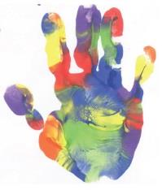
Scottish Borders Autism Strategy
Level 2a: Autism Informed
Diagnosis

Slide 2
Welcome to the first Autism Informed e-module.
This PowerPoint learning module is best viewed in Slide Show mode. If you are not currently viewing in this mode, you can switch by clicking on the “Slide Show” tab above, and then on “From Current Slide”.
Use your mouse, or the right arrow on your keyboard to move through the presentation. Some of the slides may have links to websites with video or more information. If you click on them, a webpage will open in a separate window.
At some points, you will be asked to reflect on your own experiences. You may wish to have a pen and paper to take notes of your responses.
The module should take approximately 20 minutes to complete.

Slide 3
This is the first of five Autism Informed modules. These modules build on the information and ideas contained in the Scottish Borders Autism Strategy: Autism Aware module, which you should complete first.
The Autism Informed modules will give you information and insight that will help you to understand and support Autistic people you know or work with. You might work in a role where you come across Autistic people from time to time. Or you may encounter people who respond to change in unexpected ways, or whose behaviours seem unusual to you, without you knowing whether they are Autistic. These modules will also give you a solid base to go on to further, specialist training if you work specifically with Autistic people.
All our modules have been created with advice and guidance from Autistic people, parents and carers from the Scottish Borders. Importantly, these modules have been designed to give you insight and empathy as to how Autistic people may experience the world, and the challenges they may face. Throughout the modules, we use the term “Autism” to include all Autistic Spectrum Conditions including Asperger’s Syndrome.
In this module, we will explore:
How our understanding of Autism has changed over time
How Autism is identified and diagnosed.
The possible impacts of a diagnosis

Slide 4
Understanding Autism
In the Autism Aware module, we defined Autism as
“a lifelong, neuro-developmental condition which affects the way that a person experiences the world around them and communicates with others”
Autism hasn’t always been seen this way, and our understanding of Autism continues to develop through medical and psychological research and, most importantly, through listening to the voices of Autistic people.
We can think of understanding Autism as looking for answers to two big questions:
How can we best describe Autism? eg: What are the characteristics of Autism and the criteria for diagnosing someone with Autism? How does Autism impact on people’s lives? Are there differences in the ways that males and females are impacted?
WHY do people have these differences? eg What are the differences in the way the Autistic brain functions? Is there a cause of Autism? Are there differences in biology or psychology?
In this module, we’ll explore the first question. Let’s start by with a brief history of Autism.

Slide 5
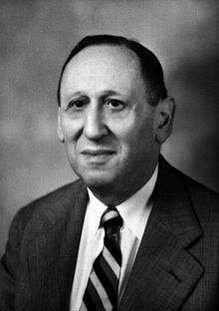
Autism: A brief history
The term Autism comes from a Greek word “autos”. Autos is the root for familiar words such as “autograph” “autobiography” and “autonomy”, and it means “self”. It was first used in the early 20th century by psychiatrists to describe a pattern of severe withdrawal from the world, which was observed in some adult patients with schizophrenia. We have come a long way since then, and now understand that Autism is not a mental illness.
Click on to learn about some of the key people in the history of Autism.
I am Leo Kanner, and I worked as a Paediatrician in the USA. In the 1930s and 1940s, I noticed some similar behaviours in a number of young children I worked with. I observed that the 11 children I studied were:
profoundly withdrawn
excellent at learning by rote
obsessive about keeping things the same
mute, had delays in developing speech, or didn’t use language to communicate in usual ways
interested in objects more than people.
The cluster of behaviours I identified came to be known as “Kanner’s Syndrome”, or “Classic Childhood Autism”.

Slide 6
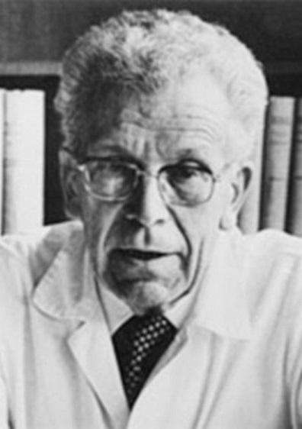
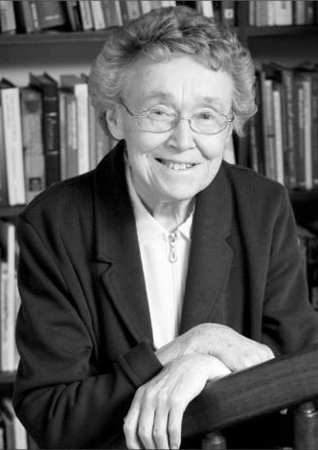
I am Hans Asperger, and I worked as a Paediatrician in Vienna. At about the same time as Kanner (though we didn’t know about each other), I worked with some boys who seemed to find it difficult to “fit in” socially. I observed that they:
Were intelligent with good vocabularies, but tended to be formal in their speech.
Found it difficult to understand non-verbal interactions
Had “fixations” on certain objects or behaviours
Could be physically awkward
Though my work wasn’t known about outside the German-speaking world until the 1980s, this has come to be known as “Asperger’s Syndrome”.
I am Lorna Wing, a Psychiatrist. In the 1980s, I carried out a study in London
with my colleague Judith Gould. We noticed that not all children fit neatly into
the descriptions that Kanner and Asperger had given. This led us to develop
two ideas that have shaped understanding of Autism to the current day.
The Triad of Impairments
Autism as a SPECTRUM condition
My research and ideas are key to the diagnostic criteria for Autism, and the
understanding of Autism as social, rather than a psychiatric in nature. I founded
the National Autistic Society the first integrated diagnosis and advice centre
for Autism in the UK.

Slide 7
Imagining the Autism Spectrum
Lorna Wing initially imagined Autism as existing on a Spectrum from mild to severe, eg describing some people as having “a dash of Autism”.
MILD
SEVERE
High IQ
Articulate
Low Challenging Behaviours
Low Social Withdrawal
High functioning
Low IQ
Non-verbal
High Challenging Behaviours
High Social Withdrawal
Low functioning
Think back to what you learned in the Autism Aware module. Do you think this is an effective model for understanding Autism? In what ways is it effective or ineffective?
In the Autism Aware module, we described how:
People can be impacted in more severe ways by some or all aspects of being autistic. Some people may face little challenge in some aspects of life, and huge challenge in other aspects.
Imagining the Autism Spectrum as a linear progression from “Mild” to “Severe” doesn’t capture the complexity of Autistic people’s experience. On the next slide, you’ll see how Rebecca Burgess, illustrator and comic artist, shows the difficulty this may cause for individuals, from her perspective as an Autistic person.

Slide 8
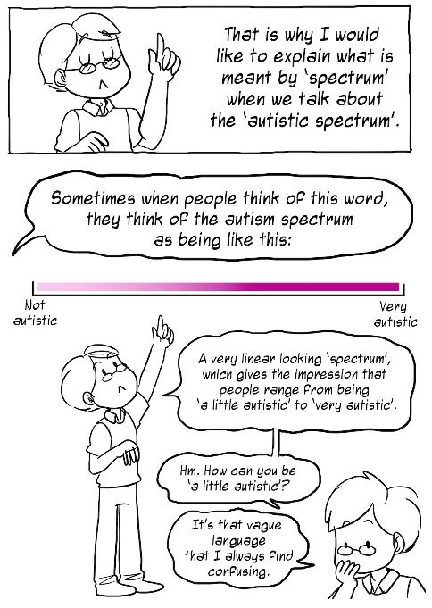
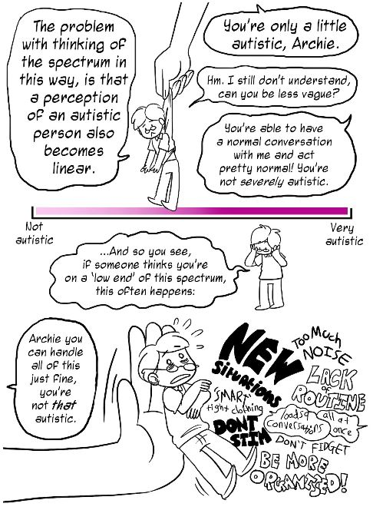
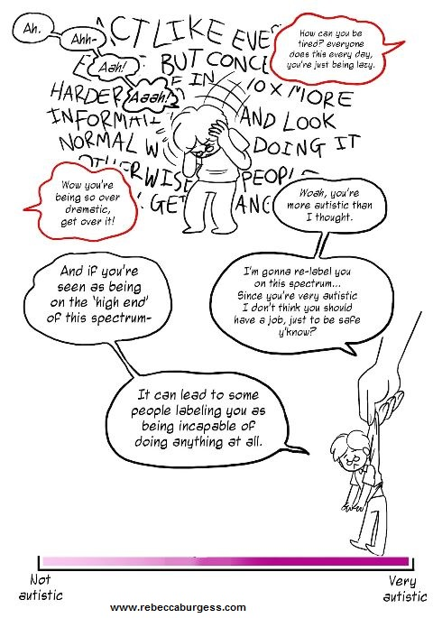
Click on to see the rest of the cartoon panels.
©Rebecca Burgess 2016
You can see the rest of Rebecca’s comic strip by clicking here
Notes:
https://the-art-of-autism.com/understanding-the-spectrum-a-comic-strip-explanation/

Slide 9
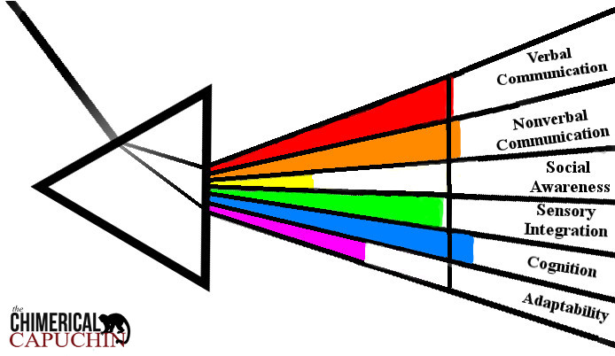
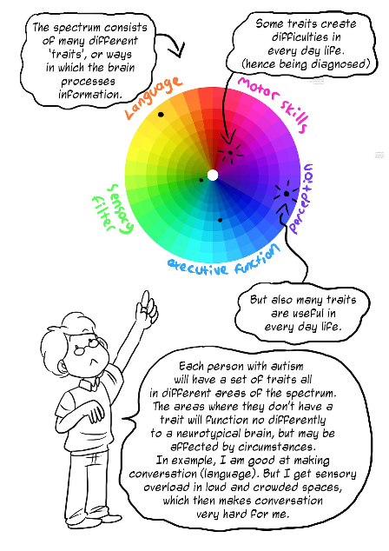
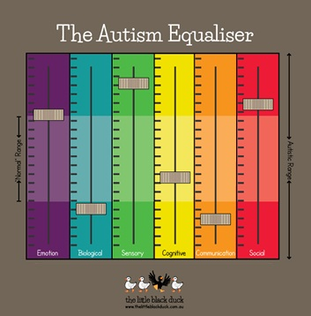
Here are three recent attempts to imagine the Autism Spectrum in a way that could more successfully capture complexity.
Does imagining the Autism Spectrum this way affect your thinking about Autism?
In what way(s)?
www.thechimericalcapuchin.com
There’s no right or wrong answer, just your own thoughts.
©Rebecca Burgess 2016

Slide 10
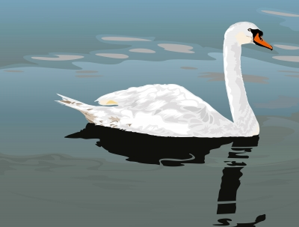
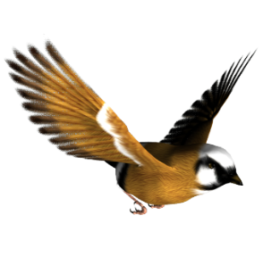
Identifying and Diagnosing Autism
Take a look at the photo.
How would you describe this creature to someone who can’t see the photo?
Image by mapichai at FreeDigitalPhotos.net
Do you remember this analogy, from the Autism Aware module?
To be a bird a species has to have six characteristics: feathers;
wings; two legs; lay eggs; backbone and warm-blooded.
A human has two legs and a backbone, but isn’t “a little bit bird”.
A creature either is, or isn’t a bird.
A diagnosis of Autism means that an individual fulfils a number of formal criteria. When someone fits those criteria, we can say they are Autistic.
But when you were describing the individual bird above, you needed more than the simple criteria. You needed to describe the colour of the feathers; the shape of the beak; where it lives; and maybe more.
Same with Autism – the criteria don’t describe an individual person.

Slide 11
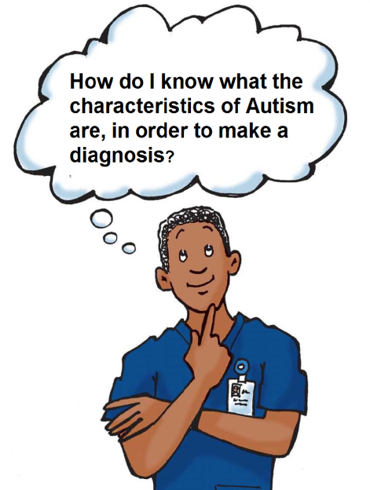
Click on to answer the medic’s question.
The characteristics of Autism are defined in Diagnostic Manuals that medical professionals use.
The International Classification of Diseases, tenth edition (referred to as ICD-10) is the main manual used in the UK.
The Diagnostic and Statistical Manual, fifth edition (DSM-V) is less commonly used in the UK, but has a significant influence on the ICD.
As understanding of Autism changes, the definitions in the manuals change, too.
ICD-10, first published in 1991, classifies Autism among a number of “Pervasive Developmental Disorders”, which include Childhood Autism, Atypical Autism, Rett syndrome, Aspergers Syndrome and Pervasive Developmental Disorder – Not Otherwise Specified (PDD-NOS).
DSM-V, published in 2013, identifies Autism Spectrum Disorder as one umbrella diagnosis.
(A revision of the ICD (ICD-11) was published in 2018, and has significant changes to the way Autism is defined. It’s not expected to be in general use for a few years, so we’ll continue to look at ICD-10.)

Slide 12
ICD-10
Listed under Pervasive Developmental Disorders, alongside other conditions.
Characterised by a triad of impairments: 1) social interactions, 2) patterns of communication, and 3) restricted, stereotyped, repetitive repertoire of interests and activities.
a pervasive feature of the individual's functioning in all situations.
Separate diagnoses for:
Childhood Autism: with onset before 3 years.
Atypical Autism: onset after 3 years.
Asperger Syndrome: differs from Autism in that there is no cognitive or language delay.
DSM-V
Specific listing for Autism Spectrum Disorder.
Characterised by a dyad of impairments: 1) social communication and interaction, and 2) restricted, repetitive patterns of behaviour.
A feature of the individual’s functioning across multiple situations
One diagnosis.
DSM-V includes sensory differences as one of the criteria relating to patterns of behaviour.
Diagnosticians are required to specific the severity of the impact of the characteristics on the individual.
What do you think might be the benefits, or drawbacks of this change in diagnostic criteria?
On the next slide you’ll see some thoughts from professionals and members of the Autistic community on the changes.

Slide 13
Focus on the shared characteristics of the Autism Spectrum.
Description of the individual within this spectrum, rather than assigning them to a specific category that may not necessarily be a good fit.
Focus on the impact of the characteristics on an individual, and the areas in which they may need additional support.
Recognition that individuals are not impacted to the same degree in all aspects of their lives.
Raises the profile of sensory differences.
Makes recognition and diagnosis more straightforward.
Removes arbitrary distinctions between social communication and social interaction.
Difficulties with social imagination are not given enough prominence.
The criteria are difficult to apply to very young children, which may lead to loss of early diagnoses.
The severity levels remain somewhat general.
In recent years, many people who have a diagnosis of Asperger’s Syndrome have been active in forging and promoting a positive identity for themselves – often choosing to proudly call themselves “Aspies”. No-one will have an Asperger’s diagnosis removed, but this community criticises the changes for removing their positive identity.
Next, we’ll look at how the diagnostic process works in the Borders.

Slide 14
Getting a Diagnosis
In the Autism Aware module, we noted that there isn’t a simple way of diagnosing Autism: there is no blood-test, scan, or simple test that can determine whether someone is Autistic or not. Because Autism impacts on each individual in a different way, diagnosis needs to be a thorough process, which explores many different aspects of an individual’s experience.
A quality diagnostic pathway has three parts:
Referral and screening
A concern about possible Autism is raised by professionals, family, or the individual themselves. A request for an assessment is made to the appropriate service and an initial assessment is carried out, to rule out any other obvious causes of difficulties.
Assessment and diagnosis
A team of professionals from different disciplines carry out assessments of the individual. They use a range of different techniques (such as observations, questionnaires and information from family) which they then discuss and decide whether the person fits the diagnostic criteria.
Post-diagnostic support
The individual (and possibly family) is informed of the diagnosis, and it is discussed with them. They are signposted to support to fulfil their needs, whether they have received an Autism diagnosis or not.
The flow-charts on the next page illustrate the diagnostic pathways for adults and children in the Borders, as of December 2018.

Slide 15
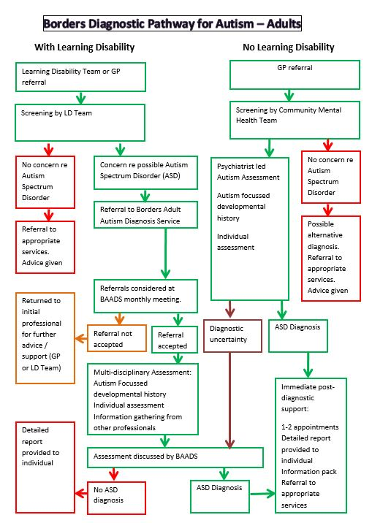
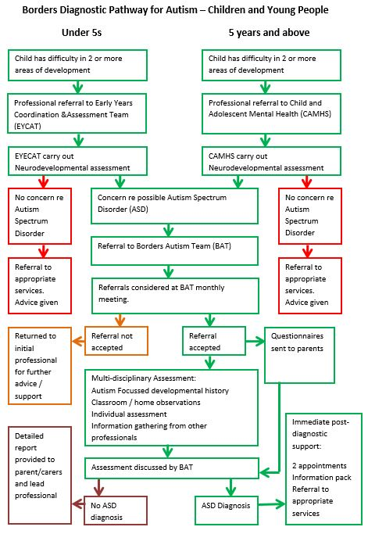

Slide 16
Professionals involved in diagnosis are expected to keep to certain standards, to make sure that people get an accurate diagnosis, are treated with respect, and don’t have to wait too long. In Scotland, guidelines for a good quality service are published by the National Institute for Health and Care Excellence (NICE) and the Scottish Intercollegiate Guidelines Network (SIGN)
The diagnosis sub-group of the ASD Reference Group for the Scottish Autism Strategy also published a quality standard for ASD diagnostic services. Here are some of their standards:
A multi-disciplinary AND multi-agency service involving professionals with ASD training;
Diagnosis ought to be a process which supports the development and progress of an individual;
Involve both the person with ASD, and parent/carer/partner/independent advocate if applicable, in the assessment and explanations;
Recognise and acknowledge cultural differences of all individuals and families;
Dedicate sufficient time for assessment in keeping with consensus timeframes;
Use information drawn from observation, standardised interview and clinical experience in a variety of contexts such as home, school, workplace and the community; include a developmental (childhood) history where possible.
Identify psychological, physical, social and other needs of the individual as well as making practical suggestions through joint planning of health, education, social work and the voluntary sector, to ameliorate any particular difficulties the individual is facing;
Give clear sensitive verbal explanations of the syndrome and provide quality written information;
Provide information about post-diagnostic services such as support groups.
Diagnostic services in the Borders are continually improving to meet these standards.

Slide 17
Impact of diagnosis
I was so pleased to have the explanation for all the difficulties I had experienced up to this point. I had found the reason for the things I struggled with and it made sense of my life, as well as changing how I saw myself, so I was able to be more confident in my position as a person with Asperger Syndrome. I was no longer someone who was awkward or stubborn.
Asdinfowales.co.uk, Autism: A guide for adults following diagnosis
At first I was really angry, and I hated it. I didn’t want to be different or disabled. I wanted to be normal.
Autistic teen, Borders.
It meant I could start to live and get the best out of life for my son.
Asdinfowales.co.uk, Autism: A Guide for Parents and Carers Following Diagnosis
I was really scared. I didn’t know whether I would cope, and wondered what I’d done wrong. I still worry for her future, and what she’ll do when I’m no longer around.
Parent, Borders
People react to a diagnosis of Autism for themselves, or their child, in many different ways. Some might feel relief or hope, others grief, fear or anxiety.
All feelings are valid, and to be respected.

Slide 18
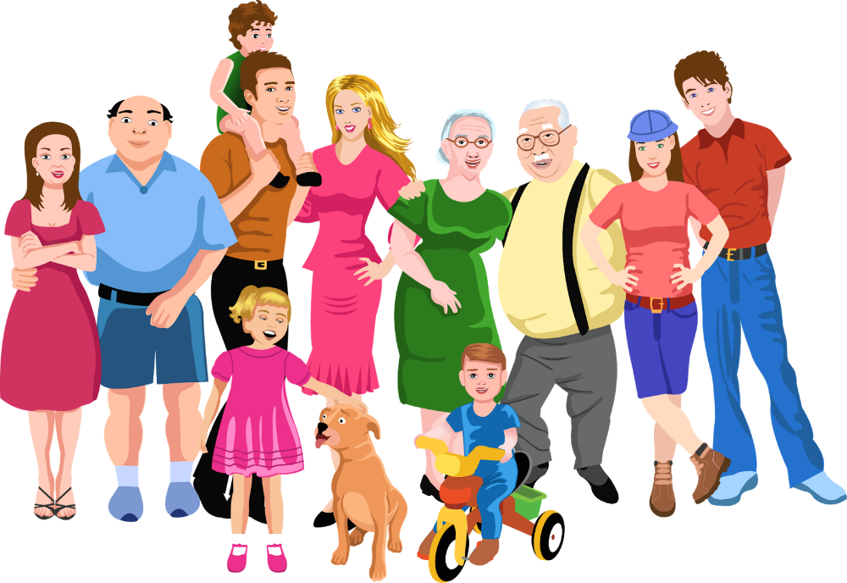
We’re going to finish by looking at something that’s often forgotten: the impact on the wider family. Click on to see some of the ways this family can find things difficult.
Mum and dad:
We feel stressed all the time, trying to please everyone. It can be difficult at work, cos we have to take so much time off for meetings and days when he can’t cope with school
Grandparents:
We don’t feel confident that we know how to look after him properly. I wish we could help more, but we don’t know how.
Aunts and Uncles:
I don’t believe that he really has a problem! My sister just needs to get her act together and be firmer with him.
Siblings:
Sometimes it feels like mum and dad don’t have time for me anymore, and we don’t do the things I enjoy. It’s hard to get peace and quiet for homework, so I sometimes fall behind, and the teachers don’t understand
Cousins:
It’s a pain! We don’t get to see our other cousins much, because everything has to be planned out.
Having an Autistic family member can bring a lot of added stress, and be a source of joy. Here’s one parent’s view:
“I am a very lucky lady to have the honour of having my son. Autism in our house stands for Always Unique, Thoughtful, Intelligent, Smart Mam’s boy. I did not know so many qualities could be in one person. Autism found him; he has made me a better person.”
Asdinfowales.co.uk, Autism: A Guide for Parents and Carers Following Diagnosis

Slide 19
If you want to learn more, check out the rest of the Autism Informed modules:
Autism Informed: Theories
How has our understanding of Autism Spectrum Condition changed over time?
How do we try to explain what Autism is?
Autism Informed: Social Communication and Interaction
A more in-depth exploration of the differences Autistic people have in communicating and interacting with others.
Strategies to promote better communication.
Autism Informed: Social Imagination
A more in-depth look at the differences Autistic people have with social imagination.
Repetitive, restricted behaviour and interests. Managing change and transitions.
Strategies to promote easier transitions
Autism Informed: Sensory Processing and Co-existing Conditions
A more in-depth look at the differences in sensory processing that many Autistic people experience.
A look at some of the common co-existing conditions.
Strategies to help mitigate sensory processing differences.
These are some useful websites:
Autism Network Scotland http://www.autismnetworkscotland.org.uk/
National Autistic Society http://www.autism.org.uk/
Scottish Autism http://www.scottishautism.org/
Autism Toolbox http://www.autismtoolbox.co.uk/
Scottish Government Autism Strategy http://www.autismstrategyscotland.org.uk/
The Welsh Government Autism information site: http://www.asdinfowales.co.uk/home/
If you click on the green link, the website will open in another window.

Slide 20
That’s the end of the Autism Informed: Diagnosis module.
Thank you
for taking the time to learn about Autism.
You can now close the slide show, by hitting the “Escape” button on your keyboard.

