Slide 1
Scottish Borders Autism Strategy
Level 2c: Autism Informed
Social Communication and Interaction

Slide 2
Welcome to the third Autism Informed e-module.
This PowerPoint learning module is best viewed in Slide Show mode. If you are not currently viewing in this mode, you can switch by clicking on the “Slide Show” tab above, and then on “From Current Slide”.
Use your mouse, or the right arrow on your keyboard to move through the presentation. Some of the slides may have links to websites with video or more information. If you click on them, a webpage will open in a separate window.
At some points, you will be asked to reflect on your own experiences. You may wish to have a pen and paper to take notes of your responses.
The module should take approximately 40 minutes to complete.

Slide 3
This is the third of five Autism Informed modules. These modules build on the information and ideas contained in the Scottish Borders Autism Strategy: Autism Aware module, which you should complete first.
The Autism Informed modules will give you information and insight that will help you to understand and support Autistic people you know or work with. You might work in a role where you come across Autistic people from time to time. Or you may encounter people who respond to change in unexpected ways, or whose behaviours seem unusual to you, without you knowing whether they are Autistic. These modules will also give you a solid base to go on to further, specialist training if you work specifically with Autistic people.
All our modules have been created with advice and guidance from Autistic people, parents and carers from the Scottish Borders. Importantly, these modules have been designed to give you insight and empathy as to how Autistic people may experience the world, and the challenges they may face. Throughout the modules, we use the term “Autism” to include all Autistic Spectrum Conditions including Asperger’s Syndrome.
In this module, we will explore:
What is social communication and interaction?
What are some of the common differences that Autistic people have in these areas?
What can make a difference for Autistic people?

Slide 4
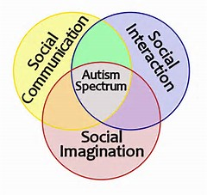
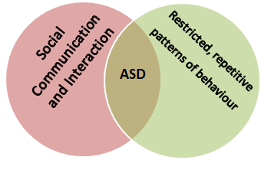
Recap
Social Communication and Social Interaction are two aspects of the Triad which has informed our understanding of Autism for many years. Identifying particular differences (or “impairments”) in each area has been key to the diagnosis of Autism. In the Autism Awareness module we stated that :
Differences in social interaction are closely tied in with the differences in social communication. There can be no communication without interaction, and no interaction without communication.
In the Autism Informed: Diagnosis module we saw that recent changes to the American medical manual (DSM-V) have combined Social Communication and Social Interaction to form a “dyad”.
We will follow this model, and explore social communication and interaction differences together in this module.
In the Autism Aware module, we busted the myths that Autistic people are all loners, with no interest in communicating with others.
Most autistic people want to communicate with others, to have friendships and to participate in social activities. Autistic people can have differences that make day to day communication and social interaction stressful, confusing or even frightening.
Because of this, Autistic people may interact differently to what neurotypical people expect.

Slide 5
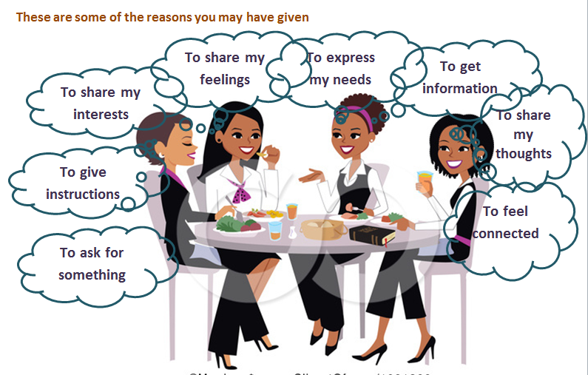
What is “social communication and interaction”?
Social communication is a two-way flow of messages, usually with a purpose, such as making a request, or sharing information.
Think about the communications you have had with people today. They might have been conversations, letters, emails, or social media.
Can you identify what the purpose of some of these were?
Click on to see some of the things you might have thought of.

Slide 6
In the Autism Aware module we saw that communication is made up of different types of language: spoken, written, pictorial or body language. To understand someone’s social communications we need to be able to decode all the messages they are sending.
Remember the baseball bat guy? In the Theory module, we asked “Is this person wanting to play, or threatening to attack?
To answer this question, you might get information from:
his body language – eg tense or relaxed; open or making himself look bigger and more dominating; moving into your personal space, or giving you room;
his gestures – eg how he is holding the bat.
his eye contact – tiny clues from the muscles around the eyes let us know whether eye contact is aggressive or friendly
He might speak, and you’d have information from his words, and his tone of voice, or other sounds he makes.
You could also get information from the context.
Are you in a park, or a dark alley? Do you know him already, and if so, how has he treated you before?
All these kinds of information are social communications.
If we can understand the messages someone is sending, we can understand their purpose and be able to respond appropriately. In this example, it could mean the difference between being safe and badly injured!

Slide 7
Understanding other people’s purpose and being able to respond appropriately allows us to have effective social interactions. Social interactions are the building blocks of society – what makes us a community, rather than millions of isolated individuals.
We have many different kinds of social interactions. They can be:
FORMAL----------------------------------------------------------------------------INFORMAL
PLANNED-----------------------------------------------------------------------------------SPONTANEOUS
EXPECTED------------------------------------------------------------------------UNEXPECTED
Or anything in between!
As people interact, they develop rules, common beliefs and expected behaviours that help to make sense of our world, and function easily within it. Following the social rules and conventions can help us to avoid conflicts, and to have other people think positively of us.

Slide 8
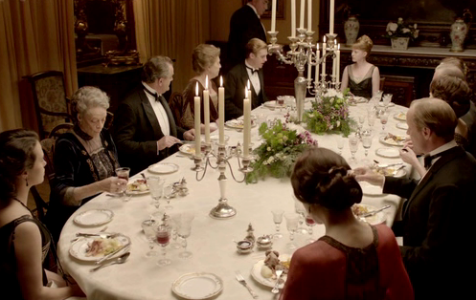
We have all experienced situations that we found stressful. Or where we were unsure of how to behave. Not knowing the social rules can leave us feeling awkward, embarrassed or stressed.
Take a look at the photos. You would probably find some of these situations more comfortable than others.
For Autistic people, differences in processing information can make all these aspects of social communication and interaction difficult.

Slide 9
Here’s a quick recap of some of the theories as to why Autistic brains may be different to neurotypical brains. Bear these in mind as you work through this module.
Theory of mind
difficulty in recognising that other people have different knowledge, experience, thoughts or intentions
Executive function deficit:
Lack of inhibition
Difficulty organising thoughts and actions
Weak central coherence:
Focus on specific, separate details
Not understanding the overall meaning or recognising overall impressions
Context blindness:
Each piece of information has one fixed meaning
Difficulty recognising and adapting to different situations
Now, let’s take a look at some of the specific aspects of social communication and interaction, and how Autistic people may experience them differently to neurotypical people.
We’ll start with what is probably the most obvious form of communication: using words.

Slide 10
Take a minute to think about how you might feel in this situation.
(There’s no “right” answer.)
Imagine…
You are in a restaurant in the middle of Paris. It’s busy and you are hungry.
You can remember some of your High School French, but not much.
The menu is complicated, and you don’t recognise many words. It’s noisy, and the waitress is speaking to you rapidly in an accent you haven’t heard before. You are trying to explain what you want, but she doesn’t understand you.
This scenario illustrates two important aspects of verbal communication:
Vocabulary: how many words can we recall and recognise?
Comprehension: how many words do we know the meaning of? Can we work out meanings from how these words are put together? Is the sound of the words spoken what we expect?

Slide 11
Our “French restaurant” example illustrates some barriers to your communication with the waitress – the things that might make it difficult for you to understand, and be understood. These might be:
remembering words,
understanding written and spoken words,
your accents,
the noise in the environment,
speed of speech,
time needed to process unfamiliar words.
Autistic people can experience similar barriers to communication in their day to day lives.
All autistic people are unique, and have different strengths and differences in the way they process verbal communication. There are some differences that are common though, and we’ll look at some of these on the next pages.
Differences in communication are not necessarily related to intelligence.
In the restaurant scene we just imagined, your lack of knowledge of French doesn’t mean that you are not smart, or that you have nothing to say. It just means that you and the waitress have a different way of communicating about the world.

Slide 12
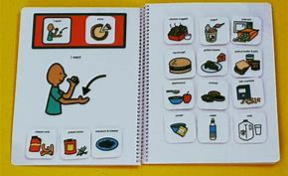
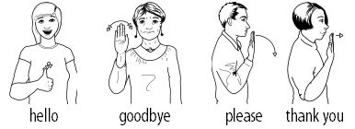
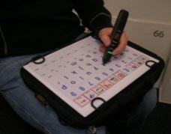
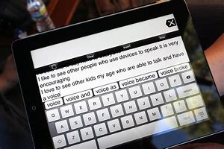
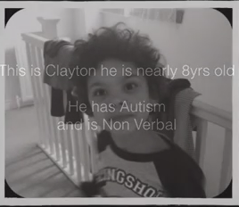
Non-verbal communication: Some Autistic people may be able to understand and use written words, but not speak. Others may not use words at all, but communicate in other ways, through sounds, or their own private language. People who are non-verbal may use communication aids. Here are some examples you might come across.
Picture or symbol systems.
Sign language: such as Signalong
These could be cards with pictures, or apps on a mobile phone, or special devices.
Adapted digital Devices:
such as special Keyboards and tablet or mobile apps.
Learning to use a communication aid can make a significant difference to someone’s quality of life.
Click on the picture to the left to see a video showing Clayton’s attempts to communicate through sounds, and the difference that learning to use a picture based system has made for him.
Sometimes, people who normally speak find that their verbal ability decreases significantly when they are stressed or distressed. They might use a communication aid at these times.
Notes:
Clayton PECS https://www.youtube.com/watch?v=zjsZG4o99DI

Slide 13
Verbal Communication: Some Autistic people may use words, but have some differences in the way they use or understand them. Here are some common examples.
Echolalia: The repetition of words or phrases spoken by others. Some autistic people may repeat the last word they have heard. Others may repeatedly use phrases they have heard from TV .
Click on the picture to see a video of a young boy with echolalia.
Word finding: In our restaurant example, we might have struggled to remember the exact French word we wanted to use, and have to think about how to communicate using the words we could remember. Similarly, some Autistic people may have difficulty in recalling words, leading to delays in responses or frustration when trying to express themselves.
Other people may have physical difficulty with forming words.
Andrew mainly uses single words to say what he needs to say and it takes him some time to get his words out.
He has to think very hard about how to say the word, and then about how he moves his mouth to make the sound he needs to.
Example from autism.org.uk/get-involved/tmi/stories
Notes:
Echolalia: https://www.youtube.com/watch?v=s9FQSCjJX9A

Slide 14
Differences in speaking style:
Tone of voice: Some Autistic people may not use their speaking voice to express emotion – their speech patterns may be “flat”, without much change in tone, rhythm or volume. Some may use different or unusual accents as part of their communication.
Over-formal or over-familiar: Typically, people use different kinds of words and phrases in formal and informal situations. (Think of the difference in tone between an email to a friend and to your boss.) Some Autistic people may not understand what kind of tone is appropriate in which setting, or may not change the way they communicate in different settings or with different people.
Click on to see an example of someone having difficulty with kind of tone of voice.
Simone attended her friend’s funeral. She hadn’t seen her friend’s partner, Jackie, for a long time.
She approached Jackie and said “Hello! How are you?!?” in a bright voice.
Simone was expressing her pleasure in seeing Jackie, and didn’t realise that this was not appropriate for the funeral.
She was really upset when her friend didn’t seem as pleased to see her, and avoided her for the rest of the day.

Slide 15
Literal interpretation When we looked before at differences in perceiving context, we saw that the autistic brain is thought to attach one meaning to a piece of information. Understanding one word as having one fixed meaning is known as literal thinking, or literal interpretation.
Neurotypical people don’t use language in this fixed, precise way. In the Autism Aware module we explored how our verbal communications are complex, with tone of voice, stress, context, and body language working together with words to change the meaning of what we say. (Remember the exercise we did around the sentence “She didn’t mean to break the window”?).
Neurotypical people often use metaphors and idioms – colourful phrases, where the words don’t have their usual meaning.
“That’s fishy!” Why is something suspicious the same as a fish?
“Hold your horses!” Asking someone slow down, no actual horse involved!
“My head is going to explode” Conveying a feeling, not something that will actually happen
or use context to imply more than the actual words used mean.
“Um… it’s VERY hot in here” Might be an implied request to open a window, not just a comment on the temperature.
“Do you have to do that?” An implied request to stop doing whatever it is.
“I’ll have it finished soon.” “Soon” could be minutes, days or months, depending on context
Autistic people often have difficulty in recognising that words can have multiple meanings depending on the context, or in understanding metaphors, idioms and implied meanings.
On the next page you’ll read an Autistic blogger talking about a childhood experience linked to her literal understanding of language.

Slide 16
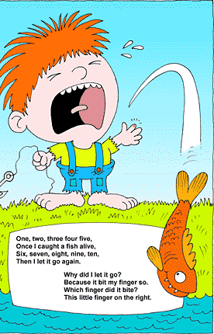
As a child, I liked singing songs. At least, I liked all songs except [this] one.
[Towards the end] I would start screaming loudly and steadily, and stick my fingers in my ears. I didn’t want a fish to bite my finger. And ‘I’ and ‘my’ refer to me when I use those words, so this would mean that a fish had bitten my finger. I couldn’t simply not sing, because the teacher had told us to sing. It was like the teacher was making a fish bite my finger. So I screamed, out of terror, because I didn’t want to sing these words, because I didn’t want a fish to bite my finger, or to have bitten my finger. I didn’t mind singing about catching a fish, because I wouldn’t mind catching a fish, but I didn’t want to sing about a fish biting my finger.
I simply didn’t understand that the song was about a fictional ‘me’, and that even though I was singing it, it didn’t really mean me, but it was more like telling a story, about a ‘her’. Perhaps if someone had explained this to me, I’d have been okay with singing it. But of course no one had explained that to me, because it didn’t occur to anyone that this needed to be explained to me. Most people see it as quite obvious.

Slide 17
Click on to reveal some more examples of people who have a literal interpretation of language.
Mark’s friend has gone to the bathroom, saying “I’ll be back in a minute”. Mark checks his watch, and starts to become anxious when a minute passes and she hasn’t returned. He gets cross with his friend when she returns three minutes later, and says that she lied to him.
Billy insisted on having a burger takeway every Friday at the end of the school week. He would become very distressed if he didn’t get this treat, but he would refuse to go to MacDonalds any other day.
Billy had heard “Friday” as “Fry Day”, and thought that this was the only day that it was right to eat French Fries.
David is 9 and often seems listless or tired in school.
He often finds it difficult to go to sleep since he read on an overhead sign on the motorway - ‘Tiredness kills’.
Example from autismtoolbox.co.uk

Slide 18
Body language and gestures
We’ve seen already that much of our communication is physical not verbal: gestures, posture, facial expressions, and body language are also used to convey meaning. Some people communicate predominantly in physical gestures , such as a member of the deaf community using sign language.
Body language and gestures could be thought of as “signs” – and like a picture or symbol, a single gesture can stand for many words. In the Autism Aware module, we explored how words, signs and pictures can change their meaning, depending on their context.
Gestures are a form of “explicit” body language, like pointing or beckoning. We tend to think that a gesture has one fixed meaning. But, just like the RED MAN road crossing sign, meaning can change with context.
Putting a finger over your lips could mean:
Speak more quietly.
Be silent.
Keep this a secret.
The meaning of gestures can be different in different cultures too.
Nodding means “yes”. Unless …. you are Greek or Bulgarian, when it means “no”!!
A Thumbs Up is a sign of approval. Unless …. you are Thai or middle eastern, when it is very rude!

Slide 19
These two people both have their arms folded.
Can you identify what non-verbal information would lead you to believe that they are expressing different things?
Most people find the question you were just asked very difficult to answer!
Many of the body language, facial expression or gesture clues we use to work out someone’s intentions or meaning are tiny and very subtle. The neurotypical brain processes a lot of this information automatically, without having to think about it specifically.
You might have identified: the different way their arms are crossed; differences in how their shoulders are positioned; different facial expression; clues in the environment (it’s snowing in the second picture!).
We don’t understand exactly how the different aspects of communication work together to convey our meaning. But we know that they do!

Slide 20
We know that in situations where the words and body language don’t match the body language is by far the most important part of the communication. Here are two examples!
In the Autism Aware module, we explored the theory that the Autistic brain processes one piece of information at a time. Much of the processing that is done automatically, or subconsciously by the neurotypical brain appears to have to be done consciously by the Autistic brain.
Imagine if, every time you had to work out whether someone was annoyed or cold, you had to put the same amount of effort into working out the clues as you just did to answer the question on the last page!
It would probably be exhausting, and frustrating.
This is what understanding communication can be like for many Autistic people.
Body language, tone of voice, context, gestures, facial expressions and the spoken word are all aspects of communication that Autistic people may have differences in understanding or using. These differences can have a big impact on people’s social interactions.

Slide 21
Social rules
Earlier in the module, we said that
As people interact, they develop rules, common beliefs and expected behaviours that help to make sense of our world, and function easily within it. Following the social rules and conventions can help us to avoid conflicts, and to have other people think positively of us.
We learn social rules in different ways.
Some rules are spelled out, and directly taught.
Most of us learn the basic social rules as children, from our parents or carers and in school.
Can you think of some other social rules you’ve been taught?
There are a lot to choose from! Some you might have thought of are:
Don’t steal. Speak when you’re spoken to. Don’t push in the queue. It’s rude to stare. You need to tell the truth. Look at me when I’m talking to you. Say please and thank you. Don’t talk to strangers. Always be kind to other people. Don’t talk with your mouth full.

Slide 22
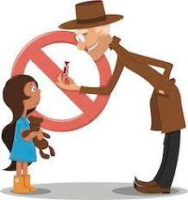
But interacting with other people isn’t as simple as having a set of rules that you follow all the time.
Some rules should be followed in some situations, and not in others.
Here is an important rule that we teach children:
Don’t speak to strangers.
Can you think of any times when someone shouldn’t follow that rule?
What might happen if someone followed the rule in the situations you just thought of?
You might have thought of
In a shop, you need to speak to the shopkeeper. If you don’t speak to them, you might not get served, or they might think you are rude.
If you are lost or hurt, you might need to ask someone for help. If you don’t speak to someone you might not get home or get the medical help you need.

Slide 23
Some rules are contradictory, and it’s not always possible to follow them both.
Always be kind to people.
Always tell the truth.
If someone asks “How did I do in my exam?” being truthful is probably most important.
If they ask “Do I look fat in this?” it’s probably most important to be kind! .
An Autistic blogger describes how she came to understand a lot of social interactions as being like talking in code.
Do I look fat in this?’ is code for: ‘I am feeling insecure about the way I look, and I would like you to reassure me.’
Autistic people often don’t spot this underlying meaning, and respond to the surface or literal meaning in the situation.
Looking under the surface, anticipating how other people might react or feel, understanding the context, and the potential consequences of following each rule are important in deciding which is most important to follow at any time.

Slide 24
Some rules aren’t “taught” at all.
In the Autism Aware module, we looked at how we choose the appropriate way to greet someone by understanding the context. We saw that factors such as our relationship with the person, the setting and the presence of other people might affect our behaviour.
Imagine you were going to teach someone the “rules for greeting people”. You would have to have one rule for every possible combination of factors that make up the context. Just to start…
Family member + like them + dinner party = rule 1
Family member + don’t like them + dinner party = rule 2
Family member + like them + business meeting = rule 3
And so on….
You can probably see how this would end up being a LOT of rules, just for this one interaction!
Because of this, many of our social rules are unspoken. They aren’t spelled out, or written down anywhere, and it’s unlikely that anyone told you directly what they are. They are social norms, or social expectations, rather than specific rules.

Slide 25
Here’s a small example:
You get onto a bus. There is just one other person that you don’t know on the bus. You go an sit in an empty seat, a few seats away from the other person.
It’s unlikely that anyone has told you that this is where you sit. It’s just “obvious”. It’s a social norm..
Neurotypical people “pick up” social norms by:
Learning basic rules, and adapting them to new situations.
Looking at the big picture, and seeing the similarities between different situations
Imitating others.
Responding to subtle clues showing the approval or disapproval of people around us.
Working out the possible consequences of different behaviours, and making decisions based on our thinking.
We’ve seen how Autistic people are likely to:
Understand things literally
Make one-to-one connections between words or symbols and meaning
See the details, not the big picture
Process information one piece at a time
This can mean that it is very difficult for Autistic people to identify and understand social norms. Many Autistic people are anxious about not knowing what is expected of them in their social interactions. Aspects of social interactions that appear obvious to neurotypical people may not be to Autistic people.

Slide 26
Here are two stories of people who find understanding social norms difficult.
Adam has been to social skills classes, where they’ve been practicing to hold a dinner party. He’s been taught that when someone arrives, you shake their hand, and offer to take their coat.
Adam was confused and upset when his friend’s sister arrived. They hugged instead of shaking hands.
Adam’s friend and sister were following a social norm: when you are close to someone, it’s ok to hug them in the context of a dinner party.
To Adam, their behaviour meant that they were breaking a specific social rule. He was confused and upset, because he has been taught that it is wrong, or rude, to break the rules.
Jenny is five. Her class teacher has explained how important it is that they put their hands up and wait for her to call on them. Jenny is desperate to go to the toilet. She puts her hand up, but there are lots of other children wanting attention, and her teacher goes to them first. After a while, Jenny can’t hold it any longer, and there is a puddle on the floor under her chair.
Jenny’s teacher explains that she could call out, if she needs the toilet, because it’s urgent.
To Jenny, rules are to be followed. She doesn’t understand why needing the toilet is different to needing help with a sum. To Jenny, both are “urgent”.

Slide 27
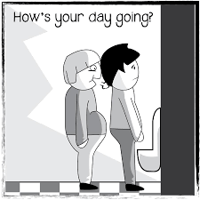
Eye contact Autistic people often have different patterns of eye contact to neurotypical people. Some people may avoid eye contact completely. Others may make very intense, prolonged eye contact, or look away at times when a neurotypical person would hold eye contact.
There are no clear rules about how long to look someone in the eye. It changes with the context. Autistic people may find it hard to know the difference between “giving eye contact” and “staring”.
Patrick describes making eye contact as feeling as intimate as kissing on the cheek. People often think he is being evasive, dishonest or uninterested because he generally avoids looking them in the eye.
Personal space This is another aspect of social interaction that has no clear rules.
It’s not appropriate to stand too close to someone else, but how far away to be depends on the context. You probably get closer to someone you know, than to a stranger. And you’ll get closer to someone on a crowded train than at a work meeting.
Mark’s colleagues have spoken to their manager about him. They feel uncomfortable around him, as he tends to stand really close to them. He’ll try to talk to them when they are on the phone, or follow them into the bathroom to continue a discussion.

Slide 28
Having Conversations Conversations with others depend on an ability to follow a lot of social rules and norms (taking turns, being polite, showing interest, choosing appropriate subject matter) and to pick up and respond to the cues of the other person (are they interested or embarrassed; do they want to speak?)
Small talk For some Autistic people, interactions that don’t have a clear purpose don’t make much sense. Autistic people often don’t participate in “small talk”, and feel most comfortable talking about things that interest them.
Sarah is very talkative but is only really interested in talking about horses. She responds to people when they speak to her, but quickly starts talking about horses, no matter what the other person is saying.
Conversational Flow Some Autistic people might not pick up on the cues that say when it is their turn to speak or listen, so conversations don’t flow in the expected way. people may rely on physical cues to show them when to speak, which can make using the phone particularly hard.
Lucy has been unwell for a long time. She hasn’t been to see the doctor. All appointments need to be made by phone call, and Lucy can’t use the phone.
Notes:
Click on pictures to reveal text in brown

Slide 29
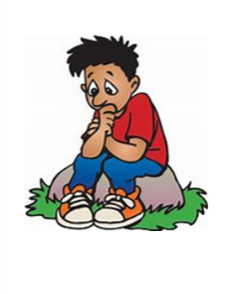
Group discussions Many Autistic people have difficulty joining in conversations in groups, especially if the conversation is informal or unstructured. It can take time to process what is being said, and to work out what to say in response.
Sarah is really fond of all her friends, and gets on really well with them one-to-one and at work.
When they are out socially together, she has a really hard time. She’s never sure which conversation to join in. By the time she’s worked out what people are talking about, and what to say, her opportunity to participate has gone. Sarah tends to avoid going out in groups, or ends up quietly in the corner not talking to anyone.. People who don’t know her well often think that she is rude , boring and anti-social.
Anxiety For some people, conversations cause a lot of anxiety. This can be exhausting, and can lead people to avoid others.
Every time Chris has a conversation he is analysing and examining it from every angle. Did he do well? Did he talk too much? Did he not talk enough? Was his anecdote really as interesting as he thought it was? He feels every mistake is like “an irrevocable mark of shame” on his record.
Example from autism.org.uk/get-involved/tmi/stories

Slide 30
Sometimes, difficulties with social interactions can lead to significant negative impacts for Autistic people. Autistic people can be vulnerable to involvement with Criminal Justice system and to evictions.
Click on to see two examples.
At a social skills group, Paul learned that one way to tell when a girl is interested is that she will smile at you.
Paul couldn’t accept that the young woman who works on the checkout at his local supermarket was just being routinely friendly when she smiled at him. He began to follow her and send her letters and gifts. Paul was arrested for stalking.
John has difficulty maintaining a tenancy. Other tenants complain that he watches TV at high volume, or hoovers in the middle of the night. John reacts very aggressively when people speak to him about this, and doesn’t understand what the problem is.
He is about to be evicted for the third time in two years.
Notes:
Click pictures to reveal text in brown.

Slide 31
Strategies
All communication is a two way process. Some organisations promote therapies such as Applied Behaviour Analysis (ABA) which try to teach Autistic people to comply with neurotypical norms and deprive them of their unique communication style. Many people in the Autistic community find this offensive and disempowering, and equate it with attempts to “cure” Autism.
Think back to the Paris restaurant scene. Imagine if someone thought the answer to your difficulties was to try to CURE you of speaking English. You would probably find that very difficult to accept!
To highlight the need to develop mutual understanding of different communication and interaction styles, some autistic people have turned our understanding on its head, and imagined having a Neurotypical Spectrum Disorder – characterised by:
Lack of ability to use language precisely
Obsession with socialising, and inability to occupy oneself
Superficial sharing of interests with others,
Reliance on meaningless small talk to aid interactions, with lack of authentic interest in responses (eg “how are you?” “lovely weather we are having”)
Use of repetitive, ritual phrases to convey dishonest meaning (eg “nice to meet you”, thanking someone for unwanted, unsolicited gifts)
Inappropriate tactile behaviour, and lack of respect for the personal space of others.
On the next pages, we’ll explore some ways that you might be able work with Autistic people to develop positive two-way communication and understanding.

Slide 32
Here are some communication and interaction differences that you may notice. Click on to see how you might be able to adapt your behaviour to help. This isn’t intended to be a check list, or rules about how to behave: it’s a flavour of some of the strategies that may be helpful.
Remember! All Autistic people are different. The most important thing is to pay attention to the individual person and adapt your communications so that they are included, respected and heard.
Standing / sitting too close or far away.
Be explicit about personal space. It’s ok to say “Can you step back a little bit, please?”
Use seating or other external cues to define personal space.
Longer processing times
Allow plenty of time for people to process your communication
Don’t reword or repeat questions or instructions! It just adds to the processing time.
Break complex questions into shorter ones.
Use pictures and diagrams to help understanding.
Literal use of language.
Try to be as precise as possible with requests, instructions or questions.
If you use idioms, metaphors or analogies, check that the person understands what you mean.
Use shorter, simpler sentences.

Slide 33
Eye contact: could be intense or rare.
Allow the person to determine levels of eye contact.
Be aware that lack of eye contact doesn’t mean lack of interest.
If intense eye contact makes you uncomfortable, gently explain this, and explain why you may have to look away.
Confusion over the purpose of interactions
Provide clear explanations of what, who, when , why, where in advance, in writing.
Some Autistic people value this for social invitations as well as professional appointments.
Appearing disinterested
Don’t assume that tone of voice and body language always represent level of interest.
Use different types of communication – verbal, written, graphics.
Use known interests to help start interactions
Non verbal communication
Don’t assume that a non-verbal person doesn’t understand what you are communicating.
Learn to communicate using any assistive technology, or picture system the person needs

Slide 34
If you want to learn more, check out the rest of the Autism Informed modules:
Autism Informed: Social Imagination
A more in-depth look at the differences Autistic people have with social imagination.
Repetitive, restricted behaviour and interests. Managing change and transitions.
Strategies to promote easier transitions
Autism Informed: Sensory Processing and Co-existing Conditions
A more in-depth look at the differences in sensory processing that many Autistic people experience.
A look at some of the common co-existing conditions.
Strategies to help mitigate sensory processing differences.
These are some useful websites:
Autism Network Scotland http://www.autismnetworkscotland.org.uk/
National Autistic Society http://www.autism.org.uk/
Scottish Autism http://www.scottishautism.org/
Autism Toolbox http://www.autismtoolbox.co.uk/
Scottish Government Autism Strategy http://www.autismstrategyscotland.org.uk/
The Welsh Government Autism information site: http://www.asdinfowales.co.uk/home/
If you click on the green link, the website will open in another window.

Slide 35
That’s the end of the Autism Informed: Social Communication and Interaction module.
Thank you
for taking the time to learn about Autism.
You can now close the slide show, by hitting the “Escape” button on your keyboard.

