Slide 1
Scottish Borders Autism Strategy
Level 2b: Autism Informed
Theories

Slide 2
Welcome to the second Autism Informed e-module.
This PowerPoint learning module is best viewed in Slide Show mode. If you are not currently viewing in this mode, you can switch by clicking on the “Slide Show” tab above, and then on “From Current Slide”.
Use your mouse, or the right arrow on your keyboard to move through the presentation. Some of the slides may have links to websites with video or more information. If you click on them, a webpage will open in a separate window.
At some points, you will be asked to reflect on your own experiences. You may wish to have a pen and paper to take notes of your responses.
The module should take approximately 20 minutes to complete.

Slide 3
This is the second of five Autism Informed modules. These modules build on the information and ideas contained in the Scottish Borders Autism Strategy: Autism Aware module, which you should complete first.
The Autism Informed modules will give you information and insight that will help you to understand and support Autistic people you know or work with. You might work in a role where you come across Autistic people from time to time. Or you may encounter people who respond to change in unexpected ways, or whose behaviours seem unusual to you, without you knowing whether they are Autistic. These modules will also give you a solid base to go on to further, specialist training if you work specifically with Autistic people.
All our modules have been created with advice and guidance from Autistic people, parents and carers from the Scottish Borders. Importantly, these modules have been designed to give you insight and empathy as to how Autistic people may experience the world, and the challenges they may face. Throughout the modules, we use the term “Autism” to include all Autistic Spectrum Conditions including Asperger’s Syndrome.
In this module, we will explore some of the Theories that attempt to explain what Autism is, and why Autistic people experience the world in different ways to neurotypical people.

Slide 4
Understanding Autism
In the Autism Aware module, we defined Autism as
“a lifelong, neuro-developmental condition which affects the way that a person experiences the world around them and communicates with others”
Autism hasn’t always been seen this way, and our understanding of Autism continues to develop through medical and psychological research and, most importantly, through listening to the voices of Autistic people.
In the Autism Informed: Diagnosis module, we thought about understanding Autism as looking for answers to two big questions. In that modules, we started to explore the first question “How can we best describe Autism?”. Now, we will take a look at the second.
WHY do people have these differences? eg What are the differences in the way the Autistic brain functions? Is there a cause of Autism? Are there differences in biology or psychology?

Slide 5
Autism: Theories
Answering the second “big question” is a challenge for researchers.
One strategy that they use is to look for a single underlying cause that would explain the differences in the areas of social communication, social interaction and social imagination. This search is made difficult by the fact that the human brain is an extremely complex organ, and there is no clear understanding of how it works. Theories about Autism fall into two main categories
Psychological theories which present explanations for human thoughts, emotions and behaviours, which are based on the way the brain processes information.
Biological theories which present explanations for thoughts, emotions and behaviour based on the way the brain is constructed.
In the Autism Aware module we used the analogy of the difference between iPhones and Android to help imagine the difference between Autistic and neurotypical brains. To continue this analogy, psychological theories explore the software, and biological theories explore the hardware.
As you work through the next sections, it’s important to remember that these are all THEORIES. They have not been proven, and some have been found to be completely incorrect. No-one has yet found a single cause of Autism, or proposed a theory which completely explains all the characteristics of Autism.

Slide 6
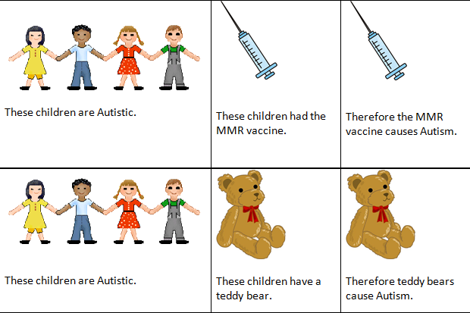
Discredited theories: refrigerator mothers and the MMR vaccine
One early theory about what causes Autism came to be known as “refrigerator mothers”. It suggested that Autism was an emotional disorder, developed as a response to “cold and withdrawn” parents. The theory has been completely discredited.
Parents are NOT to blame for an Autistic child!
A theory that attracted a wide interest in the late 20th century was that Autism is caused by the MMR vaccine. This led to many children being exposed to the risks of measles, mumps or rubella.
A scientific paper that supported this theory was discredited as containing falsified evidence.
Click on to see why this theory is also based on false logic!
Now let’s look at some theories that are still considered plausible.

Slide 7
Theory of Mind
Imagine…
You and a friend drive to the shops in your car. You park your car in Mount Street. As you both have different shops to visit, you tell your friend “I’ll meet you at the car in 2 hours.”
Shortly after leaving your friend, you realise you have no money with you, so you take the car home to fetch some. When you get back to Mount Street, it is full up, so you have to park in Park Road.
Which street would you go to, to meet your friend?
If you answered “Mount Street”, that’s because you were able to exercise Theory of Mind!

Slide 8
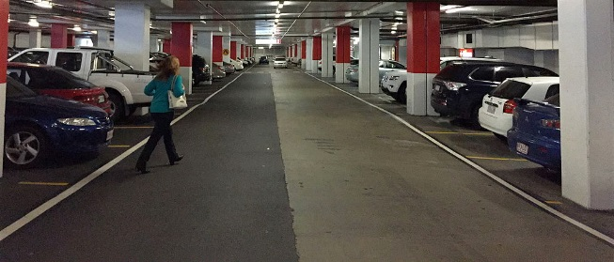
Theory of Mind can be defined as the ability to think about other people’s thinking, or:
The ability to reflect on the contents of one’s own and other’s minds, and to infer the full range of mental states (beliefs, desires, intentions, imagination and emotions) that cause action.
Think about where you decided to meet your friend.
Your thinking probably went something like this:
My friend didn’t see me move the car.
Therefore, they don’t know that I have moved the car.
They expect the car to still be parked in Mount Street.
They will go to Mount Street to meet me “at the car”.
I had better go to Mount Street, even though the car isn’t actually there.
You were able to work out that what your friend knows is different from what you know. This let you understand how they will act.
From the 1980s, there have been psychological experiments which appear to suggest that Autistic people may have difficulty recognising that other people have different knowledge or experience than they have themselves.
An Autistic person may well go to the car in Park Road, not understanding that their friend doesn’t know it has moved.

Slide 9
The Theory of Mind account of Autism goes to explain some of the difficulties that Autistic people have with social interaction and communication.
We’ll look in detail at this in the next module, for now, let’s look at one example of how Theory of Mind affects communication.
Do you think this person is wanting to play, or threating to attack you?
To answer this, you need to be able to work out what he is thinking and feeling. And recognise that it might be different from what you are thinking or feeling.
I’m thinking about making a friend, but he might not be.
I feel happy, but he might feel angry.
Someone with poor Theory of Mind may not be able to recognise what he is thinking or feeling. They may respond to him as though he is friendly, when he’s a threat. Or the other way around. That doesn’t make for good, safe communication!

Slide 10
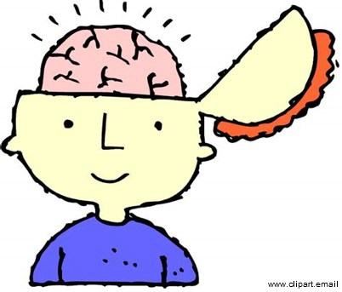
Extreme Male Brain
The Extreme Male Brain theory is a development from Theory of Mind. It proposes two brain types:
The female brain, which is empathising, concerned with human emotions and thoughts
The male brain, which is systemising, concerned with analysing and understanding rules and mechanisms.
A typical person would have a balance of both, with men leaning towards the male brain, and women towards the female brain. (You are probably familiar with this idea already!)
The Extreme Male Brain theory of Autism suggests that Autistic people lean very heavily to the male brain. This gives them a preference for rules, routines, mechanisms and predictability.
It tries to explain:
the difficulties Autistic people can have with the complexities of social interactions,
and the strengths they can display in mechanics, IT and detailed specialist knowledge..

Slide 11
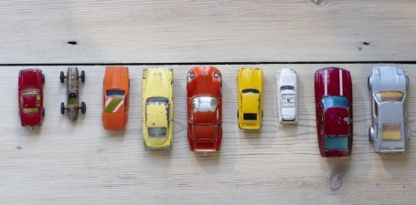
The more extreme male brain someone is, the less able they will be able to adapt to, or interact with, systems that are not 100% predictable.
One individual may line up objects in the same order again and again,
another may program computers.
The Extreme Male Brain theory also suggests that Autistic people are unable to empathise with others – to understand their feelings as well as their thoughts. However, more recent research and the accounts of Autistic people suggests that this is not necessarily true.
Asperger blogger Lynne Soraya writes:
“I consider myself a very soft hearted person. When a character in a movie or television show is embarrassed, I feel embarrassed for them. When around someone who is crying … I often feel like crying with them, comforting them. Many people with autism and Asperger's are very close to their pets, and are very nurturing and empathetic toward them.”
Researcher Isabel Dziobek ‘s study of empathy concluded that :
“People with Asperger Syndrome have a reduced ability to read other peoples' social cues but once aware of another's circumstances or feelings, they will have the same degree of compassion as anyone else."

Slide 12
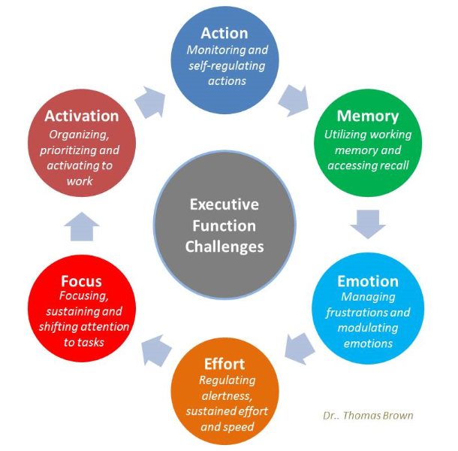
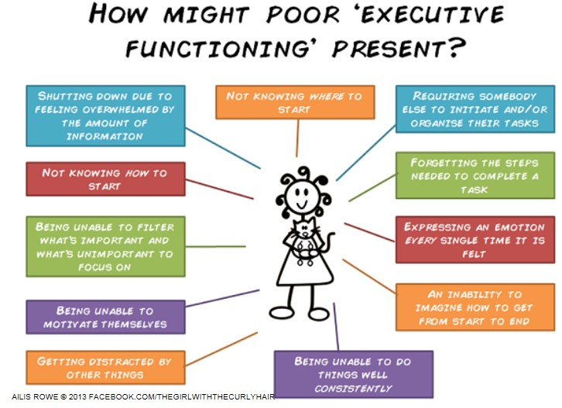
Executive Function Deficit
Executive function could be thought of as:
the brain’s management system, which organises and regulates our thoughts and actions.
The graphics below show the kinds of skills and processes this includes, and what signs of poor skills in these areas might be.

Slide 13
Cynthia Kim, an Autistic writer, notes that everything we do in daily life requires this kind of processing, often at an unconscious level. This is some of what she has to say about having difficulties with executive function.
It’s why I have so much trouble taking a break from work to walk the dog.
It’s why I write myself a list of the errands I need to run if there is more than one.
It’s why I can’t fill out a form while answering the questions that the postal clerk is asking me.
It’s why the kitchen looks like a typhoon has hit when I’m done cooking.
It’s why I insist on doing things my way even when someone shows me an easier way.
Executive Function Deficit can also go towards explaining why Autistic children often have difficulty with pretend play. Pretend play is a very complex process of organising and managing different mental images of the world, and then manipulating the concrete world to “represent” your internal reality.
To use a banana as a telephone, this little boy needs to be able to have an internal image of a telephone: its shape and how it’s used. He has to be able to compare it to the shape of the banana, and work out how to hold and move the banana to represent a phone. Those are all Executive Function skills.

Slide 14
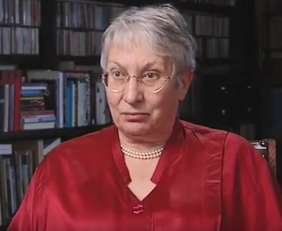
Weak Central Coherence
Central coherence can be described as:
The ability to pull together details from different sources, experiences and ideas (in both the external and internal worlds) in order to find overall meaning.
This is Uta Frith, a developmental psychologist, who first developed the theory that the characteristics of Autism could be explained by a difference in Central Coherence.
Click on her photo to watch a video of her speaking about this theory. The video will open in another browser window.
Key points from the video:
Weak and Strong Central Coherence are information processing styles
Weak Central Coherence can be a significant advantage in some circumstances, and a disadvantage in others.
Many differences in social communication, interaction and imagination can be explained by the Weak Central Coherence Theory.
Central Coherence Theory is linked to identifying and interpreting context.

Slide 15
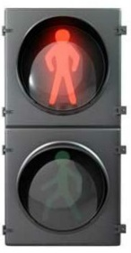
Context Blindness
The recent theory that the Autistic brain doesn’t perceive or understand context well developed from Uta Frith’s work. We explored it in some depth in the Autism Aware module. Here is a very brief recap!
The autistic brain, processes one piece of information at a time, and gives each piece of information a single fixed meaning. This can lead to difficulty functioning in a world where meaning is flexible and in constant change.
You might remember some of the examples we gave of how understanding context can lead to differences in behaviour and understanding across all three aspects of the Triad of Difference.
This can have different meanings depending whether you are on the pavement, or halfway across the road.
How you greet someone depends on the context – for example, where you are, how well you know them, who else is there.
We won’t look at this any further now, but will continue to focus on this theory in the additional Autism Informed modules, which explore the characteristics of Autism in more depth.

Slide 16
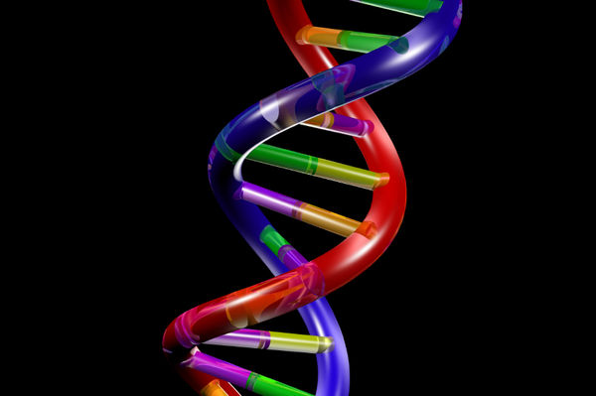
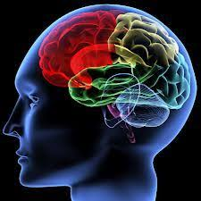
Biological causes
Biological theories of Autism are concerned with the structure of the body and brain (the “hardware”). Click on to see some information about current research into genetics and the biology of the brain.
Research suggests that there may be a genetic component to autism. Autism tends to run in families, and identical twins are more likely to both be Autistic than non-identical twins are. There is no clear evidence from genetic research, but scientist have found hints that there may be connections to differences in DNA.
Current evidence indicates that autistic brains are characterized by high levels of connection and responsiveness in the synapses of the brain. This tends to make the autistic individual’s experience more intense and chaotic than that of non-autistic individuals: the autistic mind tends to register more information, and the impact of each bit of information tends to be both stronger and less predictable.
Scans of neurotypical people’s brains tend to show similar patterns of responses. Scans of Autistic people’s brains show widely different patterns of response both from neurotypical people, and from other autistic people.
Notes:
Click photo to reveal associate text.

Slide 17
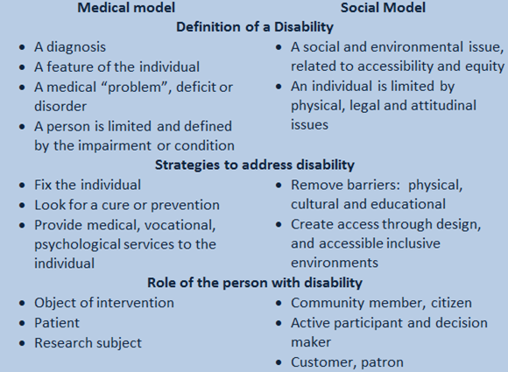
Medical / Social models
You may have noticed that most of the theories we have looked at use words like “Deficit”, “Weakness” or “Disorder”. The focus of attention has been on locating the problem within the Autistic individual: Autism has been primarily understood through the Medical model of disability. Let’s take a look at how viewing Autism through a Social Model might be different.
An Autistic child screams when they hear the school bell. What different things might be done, if Autism was understood through a medical model, or a social model? Don’t worry, there are no “right” answers!
You might have suggested something like:
Medical model: test their hearing, give them ear defenders.
Social model: change the sound of the bell to something not distressing to them.
Neither the social nor the medical model is adequate at describing disability. Each has its advantages and disadvantages. Autism can be seen as an interaction between particular characteristics of an individual, and the characteristics of their environment.

Slide 18
Neurodiversity
Neuro-diversity is the term given to a biological fact:
There is an infinite variation in the way that human brains function.
In the Autism Aware module, we saw how many people in the Autism community increasingly challenge an understanding of Autism as a problem which needs to be fixed. Whilst recognising that some Autistic people can be severely disabled, they focus on Autism as a difference to be celebrated. Taking this perspective, individuals would be described as:
neuro-typical – having a thinking and processing style which is similar to the majority of the population.
Or
neuro-divergent – having a thinking and processing style which differs from the majority of the population.
One of the main principles of this perspective, is that neurodiversity is a natural and valuable form of human diversity, just like ethnicity, gender or sexuality.
Think back to the video of Uta Frith you watched earlier.
Do you mostly remember what she said? Or what she looked like?
Some people have an aural learning style: when thinking of a film, they remember snatches of dialogue or the music. Others have a visual style: they remember images from the film.
These are examples of neurodiversity.

Slide 19
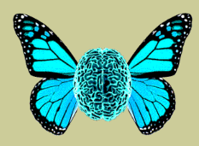
Nick Walker writes about how viewing Autism though the lens of neurodiversity could be empowering for Autistic people:
it turns out that maybe you function exactly as you ought to function, and that you
just live in a society that isn’t yet sufficiently enlightened to effectively accommodate
and integrate people who function like you. And that maybe the troubles in your life
have not been the result of any inherent wrongness in you. And that your true potential
is unknown and is yours to explore. And that maybe you are, in fact, a thing of beauty.
Critics of the neurodiversity perspective argue that it glosses over the profoundly disabling impact that Autism can have, instead focussing on those whose functioning is closer to the neurotypical norms.
Gwendolyn Kansen an Autistic writer, states that “many of us aren’t high-functioning enough to benefit from de-pathologizing autism. The neurodiversity movement doesn’t have much to say about lower-functioning autistics, who are decidedly less inspirational“. She points to those who “live in group homes, where they have to be watched like hawks so they don’t wander off and drown. They can’t talk to you. Some can’t even shower by themselves” as being examples of Autistic disabilities that can’t be described as “normal cognitive variations”.
Verity Reynolds, an Autistic neurodiversity advocate refutes Kansen’s arguments, stating that “the existence of these challenges is no good reason to curtail our human rights”. She counters that all severities of impact are addressed because: 1.) They’re cognitive variations.
2.) They exist in the human population.
3.) Therefore, they are cognitive variations humans can have.
4.) Humans can have both cognitive variations and human rights.
5.) Humans deserve to have their full set of human rights respected.
Many neurodiversity advocates call for a focus on developing more sophisticated communication aids that would enable more non-verbal, profoundly impacted autistic people’s voices to be heard.

Slide 20
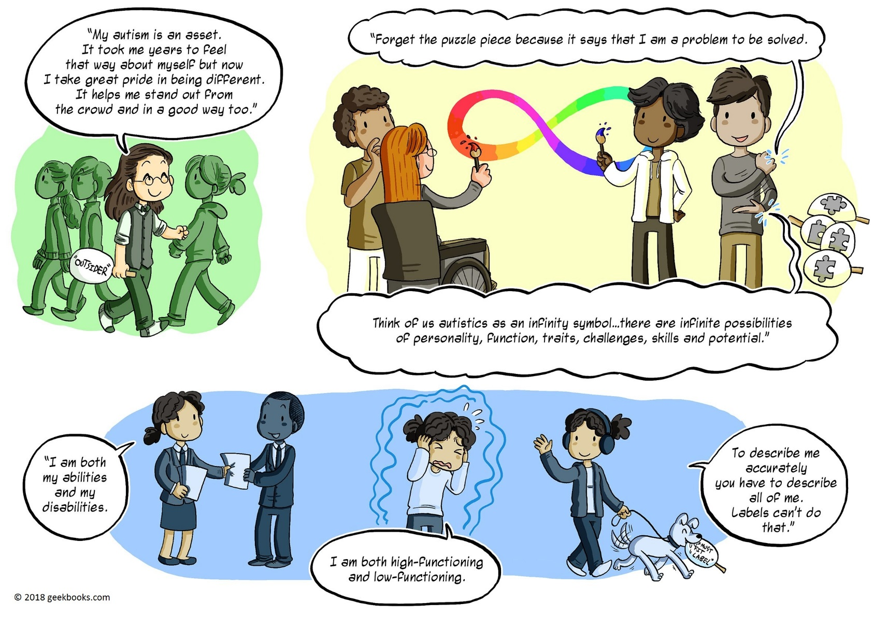
To finish, here’s Rebecca Burgess on Autism as Neurodiversity.

Slide 21
If you want to learn more, check out the rest of the Autism Informed modules:
Autism Informed: Social Communication and Interaction
A more in-depth exploration of the differences Autistic people have in communicating and interacting with others.
Strategies to promote better communication.
Autism Informed: Social Imagination
A more in-depth look at the differences Autistic people have with social imagination.
Repetitive, restricted behaviour and interests. Managing change and transitions.
Strategies to promote easier transitions
Autism Informed: Sensory Processing and Co-existing Conditions
A more in-depth look at the differences in sensory processing that many Autistic people experience.
A look at some of the common co-existing conditions.
Strategies to help mitigate sensory processing differences.
These are some useful websites:
Autism Network Scotland http://www.autismnetworkscotland.org.uk/
National Autistic Society http://www.autism.org.uk/
Scottish Autism http://www.scottishautism.org/
Autism Toolbox http://www.autismtoolbox.co.uk/
Scottish Government Autism Strategy http://www.autismstrategyscotland.org.uk/
The Welsh Government Autism information site: http://www.asdinfowales.co.uk/home/
Uta Frith presentation on cognitive theories http://vodpod.com/watch/1482153-cognitive-theories-of-autism
If you click on the green link, the website will open in another window.

Slide 22
That’s the end of the Autism Informed: Theories module.
Thank you
for taking the time to learn about Autism.
You can now close the slide show, by hitting the “Escape” button on your keyboard.

