Slide 1
Managing Sensory Behaviours
Practical Advice & Strategies
Nancy Anderson
Occupational Therapist
NHS Borders
Childrens and Young People Occupational Therapy

Slide 2
Remember
As individuals we each have our own sensory preferences and tolerances and our responses can change depending on our energy levels, mood, blood sugar levels and other factors in the environment.
Children will move between each zone at various points throughout the day, however we want to try and keep them in the ‘Winnie’ zone as often as possible so that they are able to remain focused on their activities and learn new skills

Slide 3
The activities listed below may be considered generally calming, but will have different effects on different children at different times. Sensory calming activities will also help your child when they are feeling restless, anger and frustration. Sensory calming activities can also be helpful to prevent meltdowns.
Slow, steady, rhythmic, repeated, predictable input
Slow and rhythmic music
Swinging slowly on a swing
Slow linear movements forwards -and -backwards or head –to- toe.
Rolling slowly back and forward on an exercise ball or gentle bouncing– try using music with a slow rhythmical beat to steady the child’s movement
Slowly playing row, row, row your boat
Firm, steady, pressure touch or squeezing (think massage or a big hug)
Using muscles for ‘heavy work’
Bland or sweet-tasting flavours
Slow-moving, dim, long distance views, deep colours for visuals
Neutral warmth
Chewing and blowing or breathing out

Slide 4
Deep touch pressure:
Wrapping them up, or supporting them to wrap themselves up in a blanket
Providing a firm hug or massage over their body, it is especially helpful to provide pressure by pushing down gently on the shoulders
Providing gentle but firm strokes across the body. Start from close to their body then work away e.g. from the shoulder down to the wrist. You can try using different material such as soft brushes for this
‘Squishing’ them between cushions or bean bags
Using weighted equipment such as a weighted lap pad or shoulder snake (see sensory equipment list)
Wearing clothing that provides deep touch to the skin such as a lycra vest

Slide 5
Calming Strategies
Quick Fix
Sitting under a big heavy blanket
Hands on head and pressing down
Deep pressure massage
Slow rocking on a rocking chair
Snuggling in a small space
Sucking yogurt through a straw
Bear hugs
Longer lasting Ideas
A walk after school with a backpack on
Press ups or chair press ups regularly throughout the day
Help with heavy manual tasks.
Swimming
Wearing a heavy coat or heavy blanket over the shoulders for chill out time
Squeeze or rock against a gym ball

Slide 6
Alerting Strategies Ideas for a child who is not alert enough to pay attention
Quick Fix
Up/down movements
Jumping
Clapping activities
Making faces e.g. Open mouth wide open
Stamping on the spot
Eating crunchy food
Drinking clod drinks
Longer lasting ideas
Regular routines of jumping / chair push ups
Timetable the ‘quick fix’ into the daily routine and use immediately before the child has to pay attention to a task .

Slide 7
Sensory sensitivity can lead to difficulties for children with the personal tasks of daily living
The following strategies may help.

Slide 8
Dressing
Use comfortable clothing consider the type of fabric and length of sleeves.
If they can not tolerate labels cut them off.
Avoid buying clothes the child perceives as irritating
If seams are irritating wear under garments, turn socks inside out or use seamless socks
Try washing and drying garments with unscented products
Be aware of other visual or auditory noises in the room when dressing which may be distracting or upsetting

Slide 9
Dressing continued
Allow your child to choose their own outfit
Take them shopping to choose their clothes
Make life easier for you and your child by choosing practical clothing with elasticated waistbands, velcro shoes or self-tying shoe laces
Have conversations around what makes them feel uncomfortable and attempt to understand their sensitivities.

Slide 10
Games to support dressing skills
Games:
Play dress up for example, using a mirror to increase body awareness, you can also try using different materials to help sensitivity to clothing.
Play with a dressing doll.
Draw or print an outline of a body and practice drawing on clothes.
Play with a dressing doll activity book for example, stickers or pop outs.
Make or print fabrics; try using potato prints, stencils, leaves or finger, hand or feet paints. Use the fabric to make clothes for a doll or teddy.
Play the clothes line washing game.
Ask your child to lie on a large piece of paper such as lining wall paper, draw an outline of their body. Throw beanbags at the outline and name the body parts that the bean bag lands on.
Action songs for example, Head, Shoulders, Knees and Toes, Hokey Cokey, Simon Says, I’m a Dingle Dangle Scarecrow with a Flippy Floppy Hat (try adding props).
Pretend to go on holiday and pack a bag or case. Encourage your child to select the clothing they would need to take with them (remember you can choose a sunny or a cold destination).

Slide 11
Personal Hygiene
Use non perfumed soaps
Be aware of bathroom lighting and minimise any noises e.g. Run bath before entering bathroom
Use deep pressure when shampooing , drying hair or when drying with a towel
Use calming techniques before bath time e.g. Use hands to give moderate deep pressure to the shoulders
Self initiated touch – encourage child to wash himself using large sponge rubbing firmly
When showering use a hand held shower and let the child control the direction and force of the water

Slide 12
Personal Hygiene
Use large towel and quickly and firmly wrap it round the child
Avoid exposure of wet skin to the air as the light touch may trigger a defensive reaction
Talk to your child let them know when you are going to touch them with soap or a towel
Consider the temperature in your bathroom e.g is it too cold when they undress or step out of the bath/shower

Slide 13
Hair care
Seat the child firmly on your knee
Place your hands on top of your child's head and give gentle but consistent pressure down
Use firm strokes or pressure as you brush or wash hair
Count or have the child count as you wash, brush or cut hair
Give time limits e.g. Lets count to 10 then we can stop and give deep pressure immediately after
Brush or cut hair in front of a mirror so your child can see when the brush is coming.
Try using a vibrating hair brush or a brush with a large head
Break the task into small steps and practice each task in isolation
Practice with out scissors lifting up sections of hair and gently tugging to mimic feel of cutting
Encourage your child to wash or comb their own hair.

Slide 14
Hair continued
Break the task into steps and ensure that you have all necessary items ready. It is important to: Talk through the steps.
Practice each step in isolation in a stress free environment (where they are comfortable).
Gradually, combine steps and perform the task in the place they are most comfortable.
Use conditioner and/or tangle teezer hairbrush to de-tangle hair as much as possible.
For tangles start at the bottom and work up to the root.
Try earphones or earplugs to block out the noise of clippers or hairdryer.
Use a damp cloth with firm pressure to wipe away all bits of hair after cutting to avoid irritation.
Use of a sequence story or a visual chart can help increase your child’s understanding of the task.

Slide 15
Toileting
Child may be sensitive to toilet tissue try using moist toilet roll
Consider the visual and auditory stimulation around and keep it to a minimum
Sensitivity to loud flushing noise or the hand high blast hand dryers.
Smells released during bowel movement.
Child may not like the feel of the toilet seat, it may feel cold.
Consider the sitting position of the child do they feel safe.
Give him s special toy to play with while on the toilet
Decorate the toilet or potty (let him do it)
Offer sticker reward charts and fidget toys.
Read books while on the potty or the toilet.

Slide 16
Eating and Drinking
Many young people with sensory sensitivities have eating and drinking problems
Consider the taste and texture or the food
Introduce new tastes gradually
Food textures that encourage biting and chewing are good
Vibrating toothbrushes are a good way of reducing sensitivity in the mouth but it must be on the Childs terms

Slide 17
Sleep
Develop a calming routine prior to bedtime, use quiet activities
Keep the same routine, using a visual chart or timetable can be beneficial to help with a bedtime routine
Ensure that your child’s bedroom is calming for example, dim the lights, try a mood or night light
Consider the light and noise in the surrounding environment e.g. Noise and light from elsewhere in the house.
Use heavy comforters e.g. heavy blanket, sleeping bag, make a snug area for sleep using pillows around the child
Refer to Sleep presentation on NHS Borders internet page

Slide 18
Challenging Environments consider the Childs environment and what can be done to reduce possible triggers
Is the room ;
Consider;
Noisy
Have bright lights
Dazzled by glare of sunlight
Too busy and cluttered
Has too many people
Having a quiet space/using ear protectors/ calming music through head phones
For warn them of noise e.g. School bell
Changing were the child sits of fit blinds
Have a tidy and uncluttered environment
At school allow the child to line up at the back of the line to ensure they don't touch the other children

Slide 19
General Strategies
Provide a space where the child can take them self for time out
Give the child “heavy tasks” around the house or classroom which has a calming affect
Pre-empting the need to move in the classroom and asking to do this will stop them getting up and wondering around the classroom
Provide a small toy to fidget with or distract from other sensory input
Provide clear boundaries and structures to the day
Provide warnings of change to routines

Slide 20
Possible Challenges in Relation to Touch
Challenge
Strategies
Childs withdraws or punches others who touches him lightly
Approach the child in his visual field
Ensure others know that he likes to be touched firmly explain he finds light touch uncomfortable
Tell the child when you are going to touch them

Slide 21
Touch cont.
Child may reject touch altogether from anyone other than his mother or primary carer
Ensure people approach from the front and make sure the child is able to anticipate the hug or expression of affection

Slide 22
Touch cont.
Self stimulatory behaviours are often oral e.g. Biting, spitting
Use alternative oral stimulus e.g. Chewy sweets, crunchy foods, chewy tube, chew toys

Slide 23
Summary
Observe the behaviour
Look at the possible effect of the eight senses
Look at the possible build up of sensory information over time e.g. A school day
Have a picture of the individuals preferences and sensitivities
Introduce sensory items or approaches that help calm the situation
Modify your approach with your new understanding

Slide 24
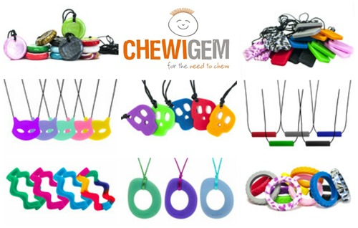
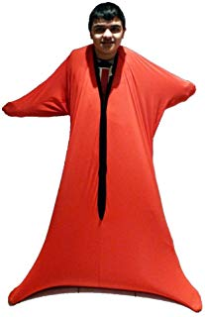
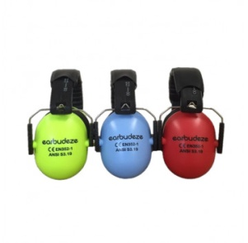
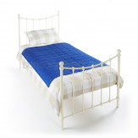
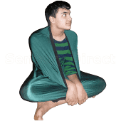
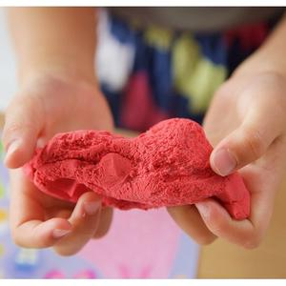
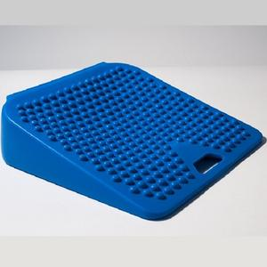
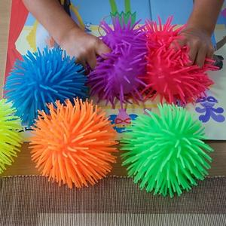
Useful Websites
www.chewigem.co.uk
www.sensorydirect.com
www.tts-group.co.uk
https:/ /fledglings.org.uk/collections/toys-sensory-learning-resources
www.cheapdisabilityaids.co.uk
Youtube films
A Childs view of Sensory Processing https://www.youtube.com/watch?v=D1G5ssZlVUw
Sensory Overload
www.youtube.com/watch?v=K2P4Ed6G3gw

